Slide 1
INTERVENTION WITH MATHLINKS
Mark Goldstein
mark@mathandteaching.org
Cynthia Raff
cynthia@mathandteaching.org
The Center for Mathematics and Teaching [a 501(c)(3) non-profit]
www.mathandteaching.org/essentials/
TODAY’S FOCUS:
WHOLE NUMBERS AND DECIMALS
Notes:
Welcome to our presentation on MathLinks: Essentials - Number Base Ten module which will focus on whole numbers and decimals.
If you don’t know us….CMAT is a non-profit and we develop middle school mathematics curriculum and resources, and support teachers in using them through professional development.
We worked together in the mathematics department at UCLA for about a decade.
Then about 14 years ago we left the university to form CMAT.

Slide 2
AGENDA
An Intervention Plan
How the MathLinks Essentials Number Base 10 module
fits into the plan
Experiences and Research
Notes:
Here is what we will cover in our presentation today.

Slide 3
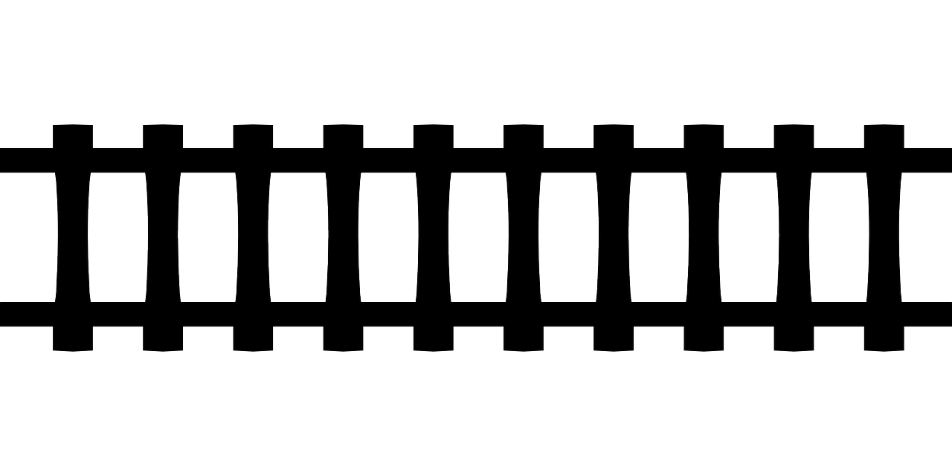
GETTING STUDENTS BACK ON TRACK
High Expectations
Backfill or frontload major topics
Increase confidence on the way to greater success
Notes:
When trying to get students back on track, of course we have to have high expectations for all of our learners. We truly believe that struggling learners are frequently just different learners, who need different approaches and strategies.
As an example, many students that are considered successful are just very good memorizers, but may not actually have deep understanding.
Conversely, many students who have not had success in mathematicscan attribute that to memorization difficulties.
So, really, their brains crave meaning to attach to concepts in order to have success.
Most interventionists choose to backfill topics, which is perfectly fine to do in filling those gaps.
However, some choose to frontload so students have a good foundation for a topic before they see it in their core class.
Some even mix the two approaches as they see fit.
We also know that intervention can’t do it all. So, almost everyone chooses the MAJOR TOPICS of a grade to maximize st
student outcomes.
This is a starting point of creating your systematic plan, intended to increase student confidence and bolster success

Slide 4
YOUR INTERVENTION PLAN
Creating YOUR plan
Identifying the major work of the grade or focus topics
Including needed review and backfill…
and frontloading if desired
Using appropriate content pitched to your students’ needs
Notes:
When creating your plan, let me emphasize and reemphasize a couple things:
You need to take a detailed and systematic approach;
You have to have a good idea up front what your curriculum will look like, what the topics will be, and how much time you intend to spend on these topics; and so with limited time, you probably do need to focus on the major work of a grade.
Though it’s certainly not required, it’s very common nowadays that we try stay close to grade level work in intervention.
So, for example, if you’re supporting 7th or 8th graders, the bulk of the major work you address may not be from these topic areas that this presentation on Number Base Ten is addressing (whole numbers and decimals), but rather something like integers, or expressions and equations. That doesn’t mean your 7th and 8th graders don’t need support with whole numbers and decimals, but it’s content pretty far below grade level and it may not be the main focus.
That being said, we DO have ideas for addressing content that’s far below grade level, even if it’s not the main focus,
and I’ll talk a little more about that later.
Additional things to think about up front: Do you know what gaps need to be filled?
If you haven’t considered frontloading, maybe you do so that students feel really successful in their core class
on a topic when their peers are seeing it for the first time.
Think about this example before getting to 6th grade, students have seen all the multiplication and most division that the standards require and that would be backfill.
And then, long division with multi-digit numbers might be a new, upcoming topic for 6th graders that they could get
some experience with BEFORE seeing it in their core class. This can be very powerful.
Of course, make sure the content is pitched appropriately to your students. A whole number multiplication worksheet
pulled from a 4th grade resource might not go over too well with 6th graders.

Slide 5
INTERVENTION COURSE GRADE 6
Today’s content focus, mostly from grades 4-6:
Whole number multiplication and division
Decimal concepts
Decimal operations
Supports major 6th grade learning goals:
Fluency with decimal and fraction operations
Proportional reasoning
Notes:
The focus of this presentation is on whole number multiplication and division; decimal concepts; and decimal operations.
These topics are primarily from grades 4-6. They support some of the major work in 6th grade, like fluency with decimal and fraction operations, and working with ratios and proportional relationships.
Note how we’re suggesting that this is 6th grade intervention work. Again, that’s not to say that older students don’t need support here – many probably do – and as promised, we will address that later.
That being said, ultimately YOU, and maybe also some of your colleagues, are the ones who determine what benefits your students the most, so choose topics accordingly.

Slide 6

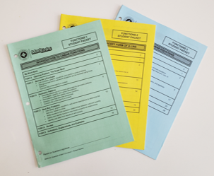
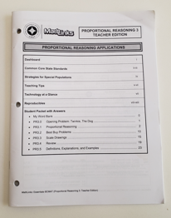
TODAY’S SOURCE MATERIALS
Student Packets
Teacher Edition
Notes:
So, let’s move on to some content.
We’re pulling these ideas from our MathLinks Essentials modules, written specifically for intervention experiences.
Here you see some consumable student packets and a teacher edition for one of our modules.

Slide 7
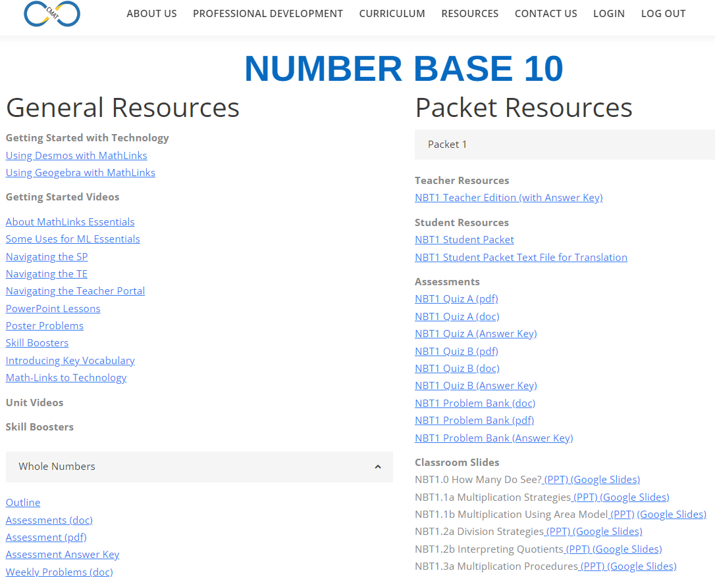
TODAY’S SOURCE MATERIALS
Teacher Portal – Online Resources
Notes:
Additionally, we’ll be pulling content from our teacher portal, which has several components that support teachers in the work beyond just what’s in the TE.

Slide 8
THE MathLinks: ESSENTIALS PROGRAM
6 Modules
Number Base 10
Fractions
Proportional Reasoning
Integers
Expressions & Equations
Functions
3
“units of study”
for each module
Notes:
Here are all 6 modules we created in our MathLinks Essentials Program.
Each of these 6 modules has 3 units of study. Modules usually span 2 or 3 grade levels.
And our users mix and match these units to create the program that best suits their students’ needs.

Slide 9
THE MathLinks: ESSENTIALS PROGRAM
Modules | Pkt 1 Gr levels | Pkt 2 Gr levels | Pkt 3 Gr levels
Number Base 10 | 4-6 | 4-5 | 5-6
Fractions | 3-4 | 4-5 | 5-6
Proportional Reasoning | 6 | 6-7 | 7
Integers | 6 | 7 | 7
Expressions & Equations | 6 | 7 | 8
Functions | 8 | 8 | 8
Grade 4-6
Foundational work
Grade 6-8
Major work
Notes:
As we look at some of the Number Base Ten lesson ideas today, think about how this grade 4-6 content addresses important foundational work that students need for success in 6th grade and beyond.

Slide 10
MathLinks: NBT MODULE
Number Base 10
First Unit: “Packet 1”
Whole Number Multiplication and Division
Notes:
Here’s NBT Packet 1: Whole Number Multiplication and Division
The 1st lesson addresses making sense of single and multi-digit multiplication
The 2nd lesson is about developing understanding for the idea of long division
And the 3rd lesson moves these ideas to their logical conclusions, which are the standard algorithms for both

Slide 11
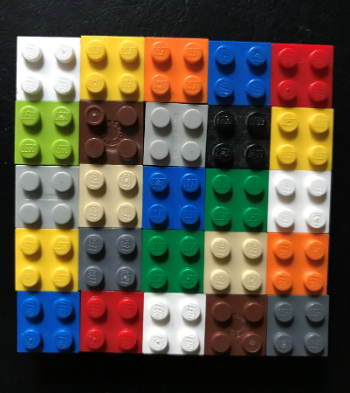
OPENING PROBLEM
How many do you see?
Explain using words and numbers.
Notes:
All packets have an opening problem to grab attention, to set the stage for the unit, and to get some discussion going.
Sometimes these problems or activities can be tied up in a short amount of time, like this one, but if it’s a meatier problem where students don’t quite have all the skills yet to complete it, that’s ok. You can always come back to it later after some teaching and learning happens.

Slide 12


MULTIPLICATION STRATEGIES
Find the product of 8 × 6.
Show or explain your strategy.
June’s Strategy:
Wade’s Strategy:
8 × 5 = 40
4 × 6 = 24
8 × 1 = 8
2 × 24 = 48,
40 + 8 = 48,
so 8 × 6 = 48
so 8 × 6 = 48
What did June do?
What did Wade do?
Notes:
And now some whole number multiplication. In our experience, many students who don’t know all of their multiplication facts at least know some. Of course no two learners are the same, and all of this varies widely, but we need to start somewhere.
We begin with single digit strategies to support the number sense of struggling learners.
See what June does to calculate 8 x 6:
She breaks apart the numbers into manageable chunks that make sense to her - - -
June knows her 5’s and 1’s…and so eight 5’s plus eight 1’s makes eight 6’s.
Now let’s look at what Wade does to calculate 8 x 6:
He breaks apart the numbers into manageable chunks that make sense to him - - -
basically four 6’s – doubled – makes eight 6’s.
We follow this up with sets of problems like 8 x 60 and 8 x 600 so students remember how and where to tack on zeros.

Slide 13
TWO BY TWO
Copy and complete the area model to find 29(51).
50
+
1
1,020
+
459
20
1,000
20
+
9
450
9
1,479
Notes:
Now we’re ready to begin multi-digit multiplication…
But we’re going to develop the concept, in a very organized and structured way, and not just go straight to the algorithm.
Here we’re going to show an area model for 29 x 51.
Students learn to break apart numbers in ways that are easy for them to multiply, namely into tens and ones.
And then they can calculate the partial products because it’s basically single digit multiplication, plus knowing where to tack on zeros.
They can add the partial products in any way that works for them to get the end product.
Notice that they’re practicing addition along with their multiplication.

Slide 14
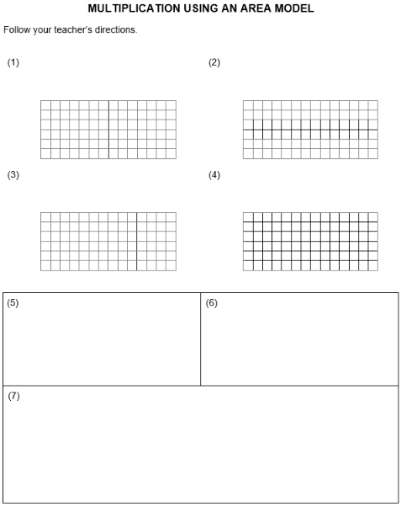
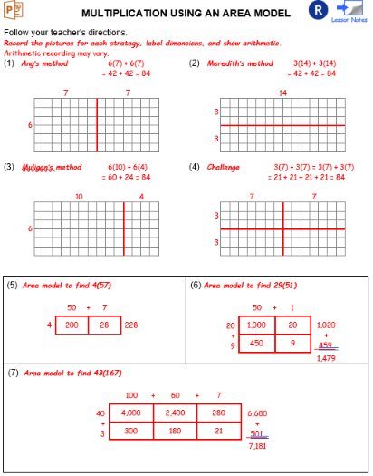
STUDENT PAGES
Notes:
Here’s something for you to think about while you’re creating your plan:
Structured workspace and lack of clutter are really needed for many struggling learners.
In our materials we like to provide that open, inviting space to write in.
For the area model problems, here you see a student page in the packet along with the corresponding answer key
from the Teacher Edition.
Though it’s not the only way to deliver instruction, we like to provide these slides that you’ve seen…
You might recognize problem 6 here, and that you’ve only seen a snippet of this area model lesson so you’d get a feel for it.

Slide 15
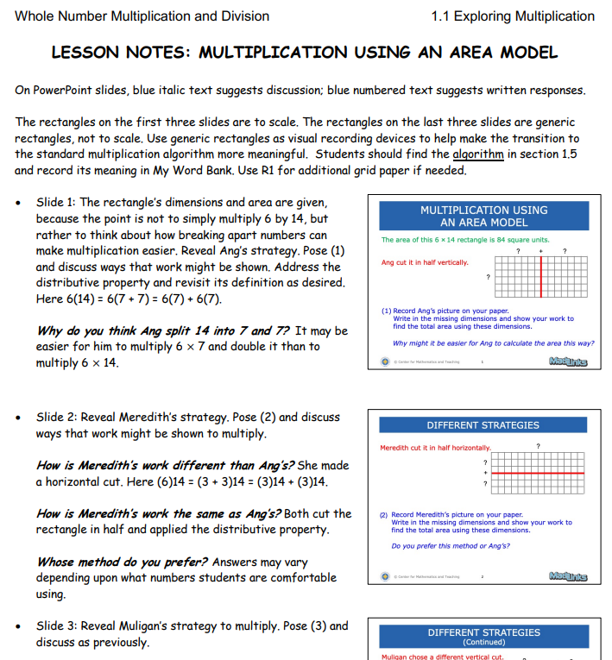
TEACHER SUPPORT IN MathLinks
Notes:
For our users, we also offer lesson notes, with small thumbnails of the slides, to help guide the instruction. It’s not a script, but it does help pace things out, and offers questions teachers can use with anticipated answers.
We encourage our teachers to review them as they prepare, and use them any way that they think works best.
But I can tell you that our teachers our grateful that they don’t have to search for ideas to make up their own lesson plans.

Slide 16
MULTIPICATION THREE WAYS
Area Model
Compute 1,096 x 85
1000 + 90 + 6
80
+
5
7,200
80,000
480
Expanded procedure
1096
× 85
30
450
5000
480
7200
+ 80000
93,160
5,000
450
30
Standard algorithm
1096
× 85
5480
+ 87680
93,160
Notes:
Back to multiplication.
Here’s an area model for a bigger problem. We like to transition to this expanded procedure, where you’ll see the partial products match up exactly to what’s in the area model. We’re focusing students on understanding that
after they do 5 x 6, they move on to 5 x 90, NOT 5 x 9, then 5 x 1000, NOT 5 x 1…And so on
Once this is all making sense, we transition them to the standard algorithm. You can see here where the partial products
in the expanded procedure match up to the more efficient and compact algorithm.
We’ve heard from many of our teachers that more students can move confidently to the standard algorithm with fewer mistakes.
We’ve also heard that some students like to stick with one of the other methods because they’re confident that they can do it right.

Slide 17
CHUNKING DIVISION
Make a multiplication bank to
help prepare to remove chunks.
Multiplication Bank
16
768
160
-320
20
1 =
10 =
448
320
2 =
20 =
32
-320
20
480
3 =
30 =
128
48
-80
5
640
4 =
40 =
64
48
800
5 =
50 =
-48
3
80
0
768 16 =
48
Compute 768 16 in a different way.
Notes:
On to making sense of multi-digit long division, which is both kind of new and kind of familiar to 6th graders, and definitely review to older students.
We like to call this strategy chunking division, because we repeatedly pull chunks of the divisor off by subtraction until we can’t anymore. It’s proven to have led to successful outcomes with struggling learners.
First we make a multiplication bank, which you’ll see is great multiplication and addition practice.
We can make as many multiples of 16 as we like, and here you’ll see we’ve chosen to go up to 16 x 5, but you do more of fewer if you like.
We know 16 x 1
Then we discuss how we can double that to get 16 x 2 (like maybe two 10’s is 20 plus two 6’s is 12, and 20 + 12 is 32)
How do we get 16 x 3? Maybe add one more 16, a 10 and a 6.
And 16 x 4? Maybe add one more 16. OR maybe double 16 x 2
And then 16 x 5? Maybe add one more 16. Maybe combine 16 x 2 and 16 x 3.
Then the 10’s follow pretty quickly and are very useful as we get ready to start dividing
Now with a dividend of 768. I might go all the way to 640, 40 groups of 16, but some students may start smaller, or maybe they don’t have a big multiplication bank and that’s perfectly ok.
Here we’re showing taking a group of 20, another group of 20, a group of 5, and finally a group of 3 until there’s nothing left…and then we ask students to use different chunks to solve it again.

Slide 18


123$÷$5=24 R3
Study the problems below. Write what each remainder means. Then write the answer to each problem.
There are 123 packages of pencils. If 5 packages fit in a box,
how many full boxes can be filled?
There are 123 soccer players that are going to a tournament.
If 5 players can fit in each car,
how many cars are needed to take all of the players?
Notes:
Making sense of division is important. Here’s a division statement that includes a remainder.
Here you see two problems and you can see how they’re the same and how they’re different.
For the 1st one - we fill up 24 boxes… and that’s it, we’re done.
For the 2nd one - we need to get all the players to the tournament, so because of the remainder we need the 25th car.

Slide 19
MOVING TO THE STANDARD ALGORITHM
(2) Compute 963 14.
Chunking
Standard Algorithm
68 R11
6
14)963
8
R11
14)963
- 840
60
- 84
123
3
12
- 112
8
- 112
11
11
Notes:
And like with multiplication, we want to get to the standard long division algorithm.
Note that there would be a multiplication bank which isn’t shown. With chunking we can pull out 60 groups of 14
and then another 8 groups and still have 11 left over.
See how this connects to the standard algorithm, which is certainly more compact and efficient, but really the actual number sense is obscured.
We ask if 14 goes into 9, and say no, and then move to 14 into 96, and that’s a yes.
I don’t know about you, but I can see how that might be a confusing process to students. But after understanding long division concepts through chunking, it might be a bit more reasonable that we’re now taking shortcuts, and where those shortcuts come from.

Slide 20
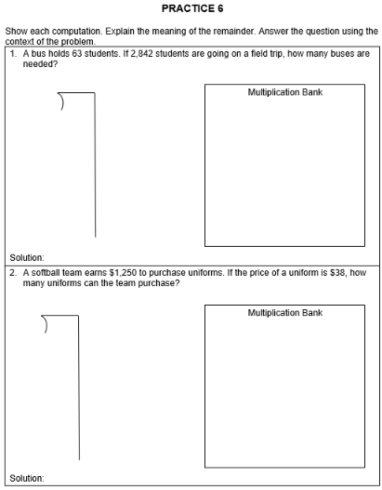
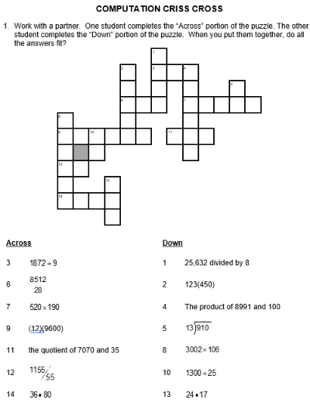
REHEARSAL IS IMPORTANT
Notes:
We always follow concept development in the student packet with practice, and not all of our practice looks like a worksheet. Sometimes practice is in the form of a puzzle or a game.

Slide 21
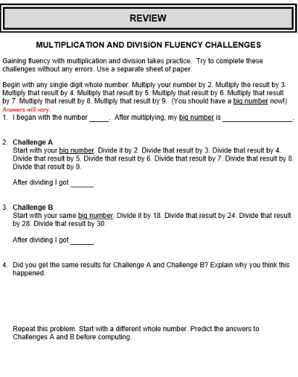
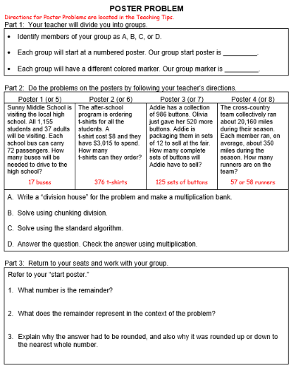
UNIT REVIEW
Notes:
There’s a review section in each packet with some activities that are usually good for collaboration.
This one goes through a chain of multiplications, and then a succession of un-doings of multiplication by division to get back to where you started.
And this set of poster problems has students in groups of 2-4 doing parts of different, similar problems with partners
as they travel around the room to different posters. They do some work on one poster, then rotate and check the next poster’s work, plus do the next step of that problem, and then on to the next poster to do the same, and so on till it’s all done. Our teachers and students have loved these over the years.

Slide 22
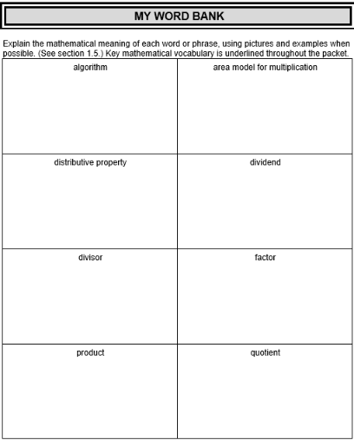
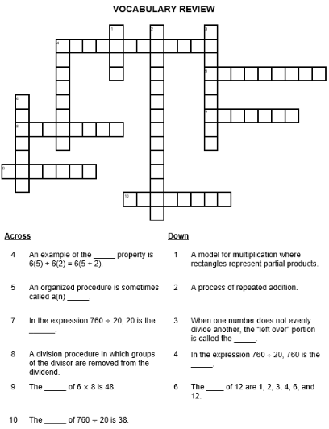
VOCABULARY SUPPORT
Notes:
Vocabulary is important.
Near the start of every packet is a word bank. These words are addressed in context as they come up.
Teachers support students in unpacking the precise definitions to write something meaningful in the box –
maybe in their own words, maybe an example, maybe a picture. Whatever’s helpful.
And near the end of every packet is a vocabulary crossword puzzle for practice.

Slide 23
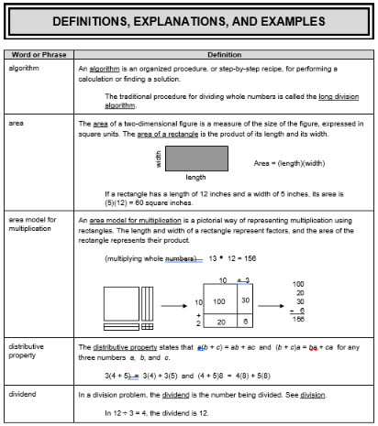
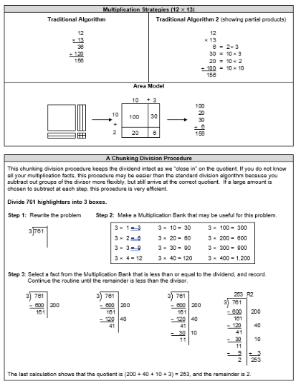
STUDENT RESOURCE SECTION
Notes:
The last section in our packets has those precise definitions and examples and explanations.

Slide 24
MathLinks: NBT MODULE
Number Base 10
Second Unit: “Packet 2”
Decimal Concepts
Notes:
On to the second packet focusing on Decimal Concepts
Here we address decimal fraction concepts and notation, locate decimal numbers on the number line, and dive into fraction-decimal equivalence.

Slide 25
DECIMALS: DEFINING THE WHOLE
If the small square has a value of
one square unit of area, then:
What is the value the stick?
10
What is the value of the big square?
100
Write the value of each shaded part
and its word name.
(1)
(2)
(3)
Notes:
Early on in this packet we use base 10 blocks, or simple pictures of them if you prefer, to make sense of decimal fraction concepts and notation.
The small square is defined as the unit…as 1. And so it follows that the stick is 10 of those and the big square is 100.
And then we practice.

Slide 26
CHANGING THE WHOLE
If the stick has a value of
one square unit of area, then
What is the value of the small square?
What is the value of the big square?
10
Write the value of each shaded part
and its word name.
(4)
(5)
(6)
Notes:
Then we change it up. Now the stick is 1
So the small square is 1/10 of that
And the big square is 10 of those.
And then we practice.

Slide 27
CHANGING THE WHOLE AGAIN
If the big square has a value of
one square unit of area, then
What is the value of the stick?
What is the value of the small square?
Write the value of each shaded part
and its word name.
(7)
(8)
(9)
Notes:
Finally, the big square is the whole
So the stick is 1/10 of that
And the small square is 1/100 of that.
And then we practice.

Slide 28
PLACE VALUE: EXPLORING BASE 10
What do you notice in the transition from the ones to the tens to the hundreds?
What do you notice in the transition from the hundreds to the tens to the ones?
What do you notice in the transition from the tenths to the hundredths to the thousandths?
Notes:
It’s important for students to make sense of place value, and to understand that each successive place is 10 times that of the one next to it OR 1/10 of it, depending upon whether the place values are increasing or decreasing.

Slide 29

NUMBER LINES WITH TENTHS
Let’s zoom in.
What’s happening between 0 and 1?
0
1
0
0.1
0.5
1
Copy the given numbers. Then label all tick marks on the number line.
What is the distance between each pair of consecutive or adjacent tick marks?
Notes:
In the common core, number lines are tools that begin in the early grades and continue throughout every year of mathematics.
Locating decimal values can be tricky. Zooming in helps students visualize these tenths locations better.

Slide 30
NUMBER LINES WITH HUNDREDTHS
Recall…
What’s happening between 3 and 3.1?
3
4
3.0
3.1
3.4
3.9
4.0
Let’s “zoom” in a little closer.
Notes:
Between wholes are tenths…

Slide 31
TAKING A CLOSER LOOK
Let’s zoom in to see what’s happening…
3.0
3.1
3.00
3.01
3.05
3.09
3.10
Copy the given numbers. Then label all tick marks on the number line.
How many segments of equal length are there from 3.0 to 3.1?
What is the length of each of these segments?
Notes:
..and so between tenths are hundredths.

Slide 32
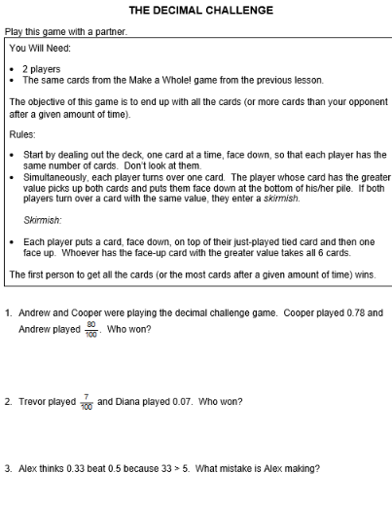
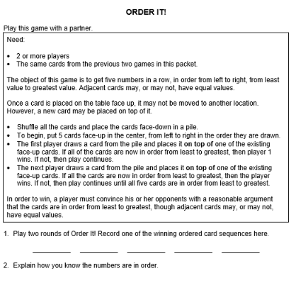
PRACTICE
Notes:
There is ample practice to follow all concept development.
Rather than showing you practice worksheets here you see a couple card games. We provide blackline master reproducibles for the decimal cards.

Slide 33
MathLinks: NBT MODULE
Number Base 10
Third Unit: “Packet 3”
Decimal Operations
Notes:
The third and final packet in the NBT module is on Decimal Operations.
Lesson 1 reviews decimal addition and subtraction.
Lesson 2 is multiplication.
And lesson 3 is division.

Slide 34
ADDING AND SUBTRACTING DECIMALS
Write three tenths plus sixty-four hundredths as a numerical expression.
Shade in 0.3 plus another 0.64.
Write the total shaded part in
words and with numbers.
Look at the two original numbers. Where did the 9 come from in the total?
When we add decimals we have to add numbers with the same place values together, just like when we add whole numbers.
“Line up decimal points” when adding.
Notes:
We first use visuals to make sense of addition, and use the same kinds of pictures for subtraction, and make sense of why we line up decimal points.
After some practice and applications we move to the next lesson pretty quickly.

Slide 35
MULTIPLICATION AS REPEATED ADDITION
Let each stick equal one whole. Copy the expressions.
Use repeated addition to find the products.
3(0.4)
= 1.2
0.4
0.4
+0.4
1.2
or
Notes:
Multiplication begins as repeated addition:
3 groups of 4 tenths looks like this on the left or this on the right.

Slide 36
AREA MODEL
Let the big square equal one whole. Copy each expression.
Use an area model to find each product.
0.7 0.4
= 0.28
(0.1)(0.9)
= 0.09
0.7
0.9
0.1
0.09
0.4
0.28
Notes:
When both numbers include decimals, we move to the familiar area model.
Here it’s important to understand that this is a big 1 by 1 square so that 7 tenths is represented by this length across the top that is 7 of 10 units along the way and 4 tenths is represented by this length down the side which are the dimensions of this rectangle that has an area equal to the product – 28 hundredths of the whole.
Let’s try it again for 1 tenth multiplied by 9 tenths.
1 tenth of the way by 9 tenths of the way gives us a rectangle equal to 9 hundredths of the area of the whole.

Slide 37

FROM CONCEPTS TO PROCEDURES
Using repeated addition and area models we have established that:
(3)(0.2) = 0.6 and (0.3)(0.2) = 0.06
Make a conjecture about these products.
a. (0.3)(0.02)
c. (0.03)(0.002)
b. (0.03)(0.02)
d. (0.003)(0.002)
Explain how to place the decimal in the product.
Notes:
We ask students to make observations so they can make a conjecture about decimal placement for the multiplication rule.

Slide 38
QUOTIENTS THAT INVOLVE DECIMALS
Recall this problem:
Four friends share $3.12 so that each one gets the same amount. How much will each friend get?
Use a standard algorithm to divide:
Write a “division house” problem for this situation.
Then place the decimal point so the
quotient makes sense.
Notes:
And that leaves only division to wrap up the lessons in this packet.
We start by building off of the known whole number division procedure.
With a context we try to make it reasonable where to place the decimal here. And once that makes sense, the process with decimals isn’t really much different than with whole numbers.
By the way, note that this example is a decimal number divided by a whole number.

Slide 39
NOW QUARTERS
How many quarters are in $4?
Use a diagram so show a solution.
In other words, how many ____ are in ____? Multiply by the big 1.
Shortcut to relocate the decimal point:
4
100
0.25
100
What did you multiply by to remove the decimal in denominator? Why?
Divide 60 by 0.24 using a standard algorithm.
Notes:
Using money can be helpful sometimes, and this is one in a series of problems with different coins to make sense of dividing BY a decimal.
First students draw a picture to make sense of the problem.
Then moving to numerical representations to help make sense of how and where to move the decimal points.

Slide 40
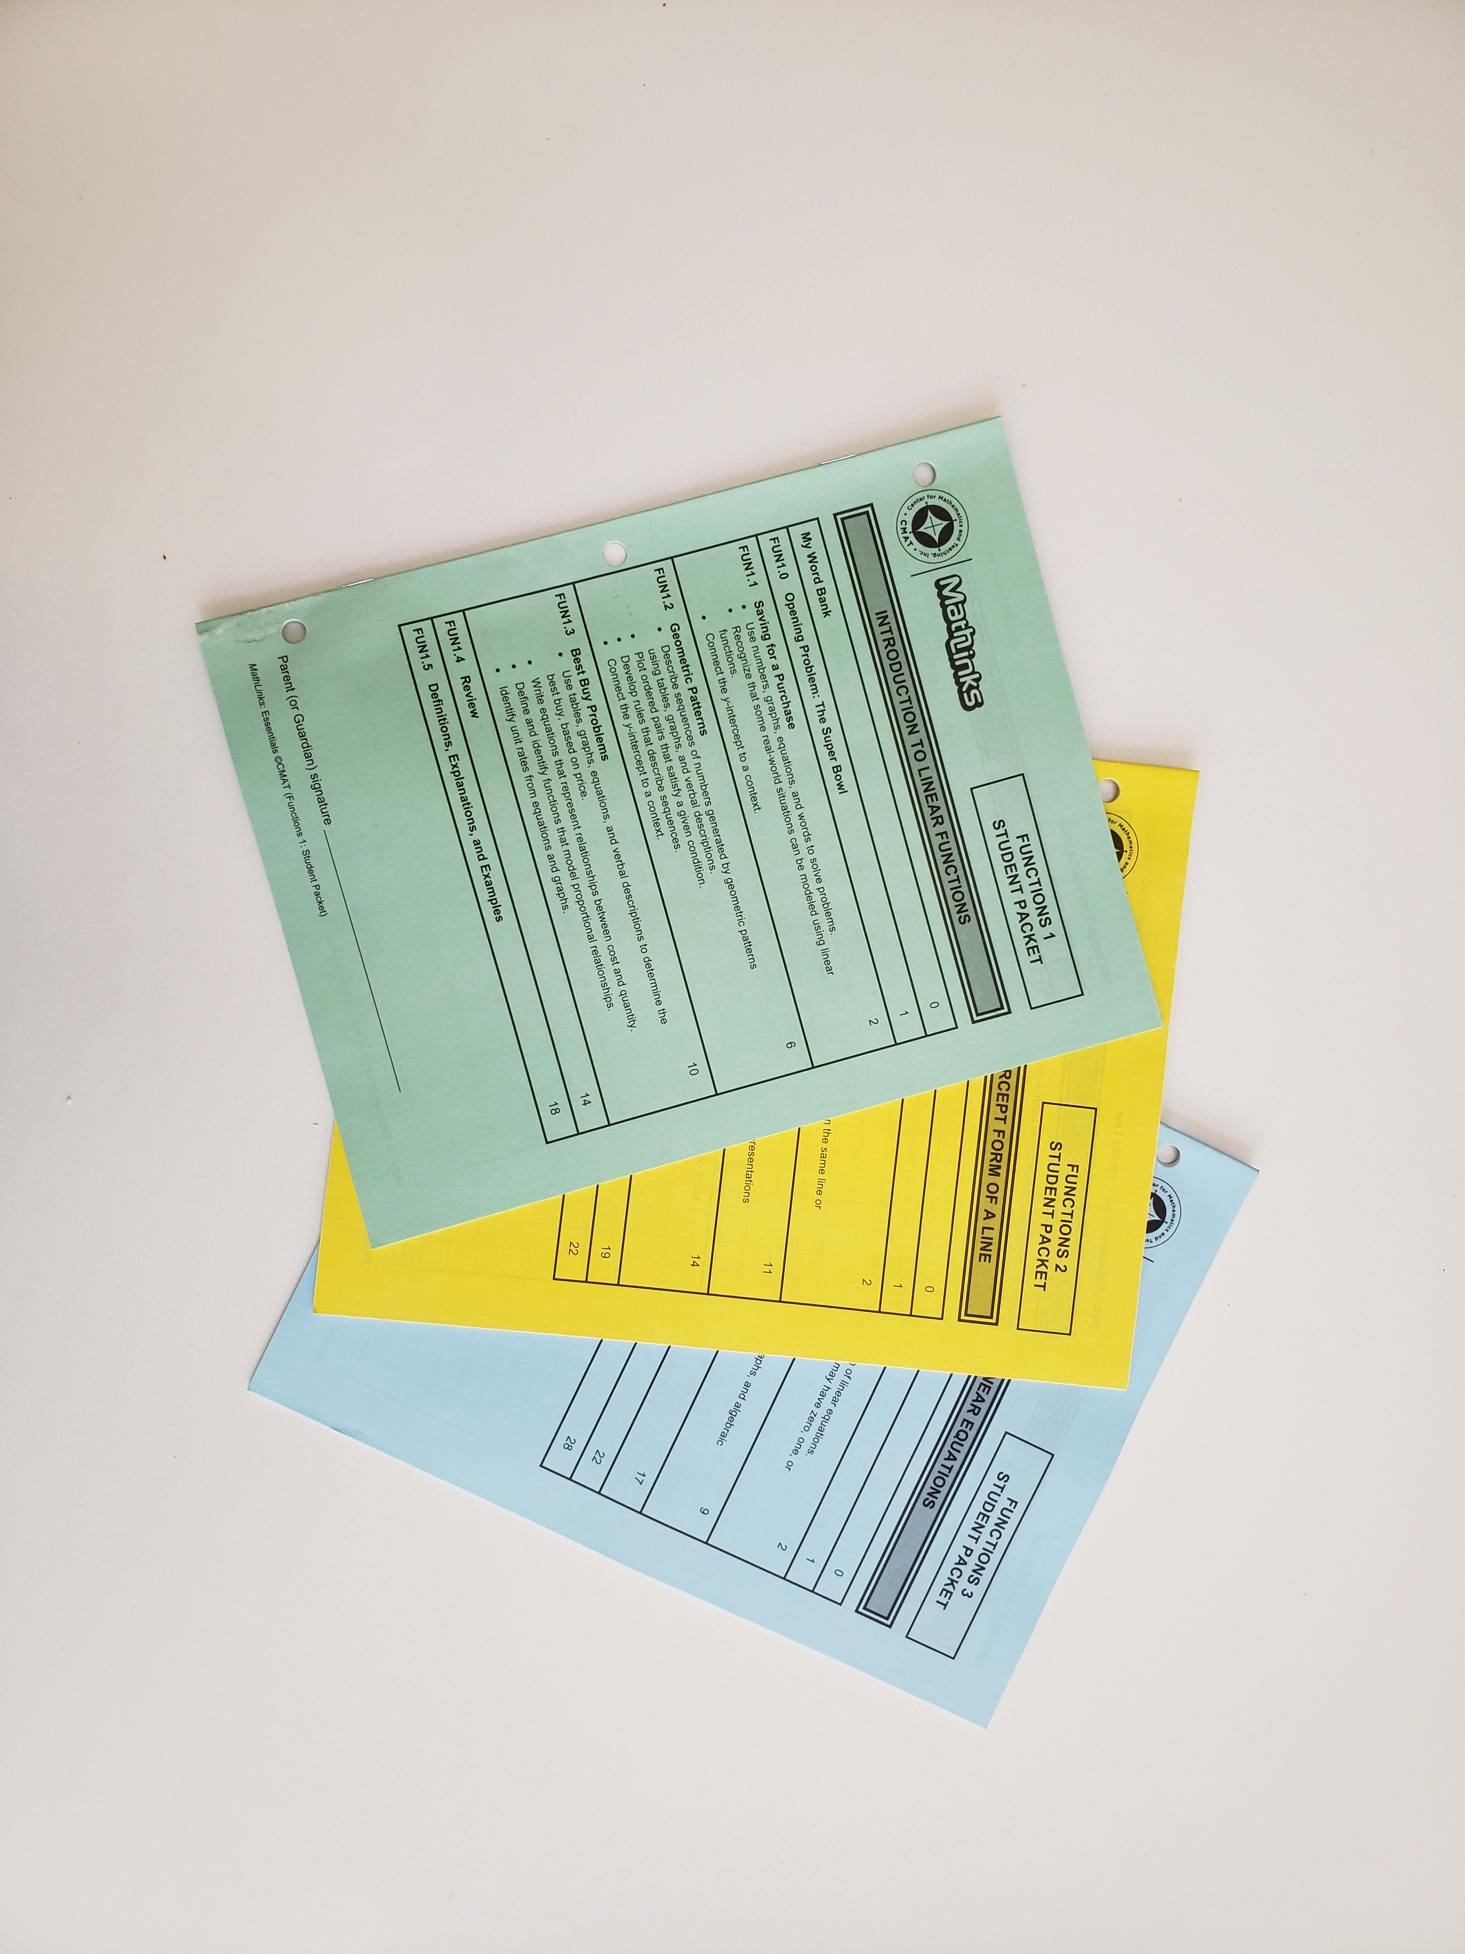
STUDENT PACKETS
Every packet includes:
An opening problem
Attention to vocabulary
Three multi-period lessons
Review activities
Definitions, explanations, and examples
Notes:
Now that we’ve gone through some of the content, let me remind you of what you’ve seen.
Every student packet is put together the same, and here are some of the things you already saw.

Slide 41
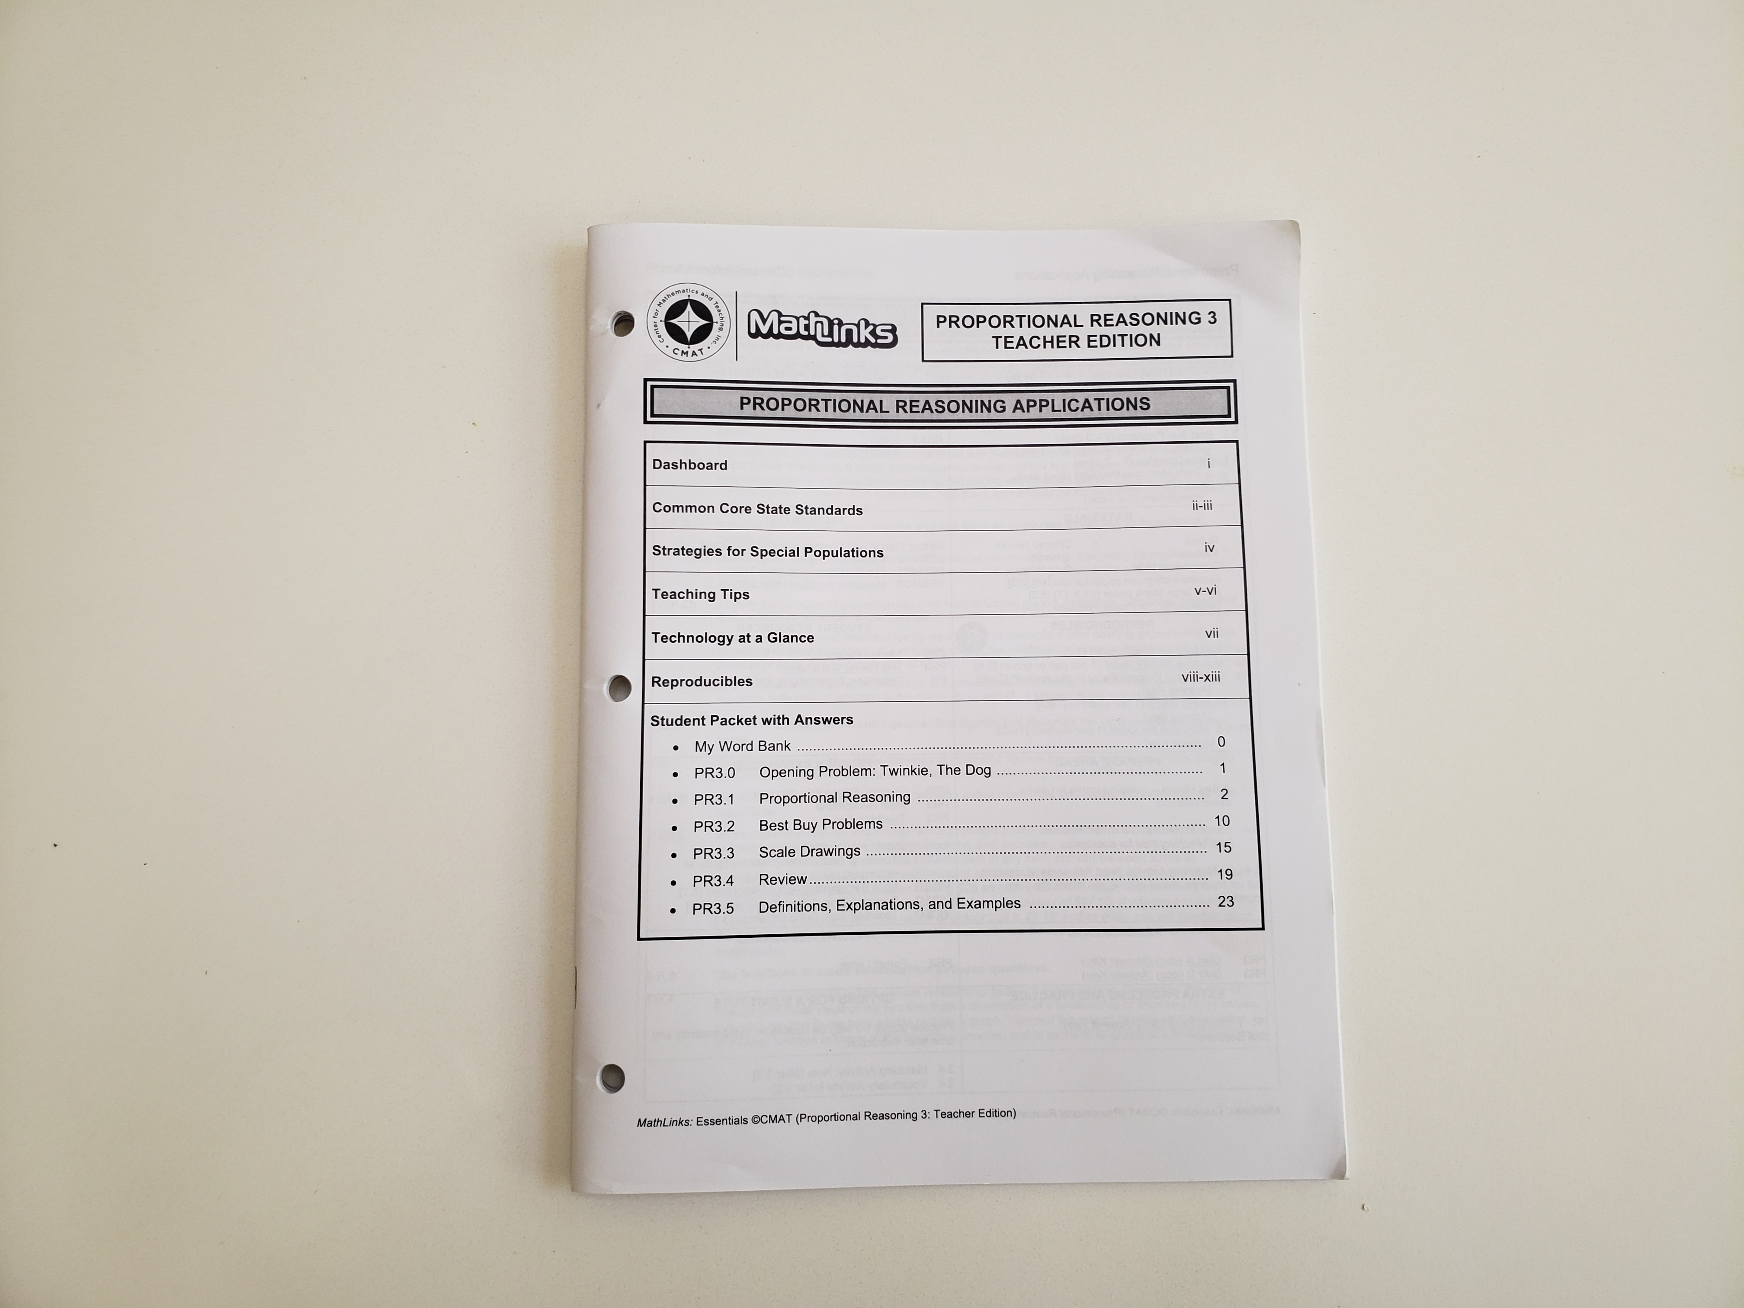
TEACHER EDITION
You’ll find:
Planning dashboard
Standards
Teaching notes
Tech activities
Reproducibles
Answer key
Lesson plans with
slide decks
Notes:
And you also saw parts of the TE

Slide 42
WHAT THE RESEARCH TELLS US
Ongoing Formative Assessment and Feedback
Alternate Strategies
Rehearsal
Balance Basic Skills and Conceptual Development
Teacher Support
Notes:
Though we’ve had years of experience, and we always listened to our teachers as we put together our programs
we also consulted the research.
Here are some of the main takeaways we kept reading in the literature, so we made sure to incorporate them.

Slide 43
WHAT THE RESEARCH MEANS
Do we need to test our struggling learners a lot?
How can we support teachers in this work?
If Basic Skills AND
Conceptual Development
are both important,
how do you pull that off?
Must students know more than one strategy?
What’s the right kind
of rehearsal/practice
and
how much is the right amount?
Notes:
Let me try to explain a little more clearly.
We’re not suggesting to test our intervention students a lot. But they really need more frequent feedback and guidance
than students who have had more success.
We don’t recommend peppering students with a bunch of strategies, but sometimes offering more than one, and then helping them pick the one that they like, is really beneficial. Think about the area model for whole number multiplication,
the expanded form, and the standard algorithm. If students are proficient in one, maybe they don’t need the others.
The right amount of practice could be different from student to student. But teachers know their students best, so we offer options, with practice pages, practice games and puzzles,and extra problem sets.
With every example, we tried to show you how we start with concepts, make them reasonable, and guide students to the rules and procedures. It’s important for ALL learners to get that kind of instruction, but it’s especially important for struggling learners. Since memorization may not be their strong suit, they crave meaning and connections for things to make sense.
And of course, teachers need support, and we gave you some evidence of how important that is to us.
To provide materials that are complete and easy to use, and all right there in one place for you.

Slide 44

MathLinks ESSENTIALS: RESEARCH BASED
RTI Action Network
http://www.rtinetwork.org/middle-school
What Works Clearinghouse
http://ies.ed.gov/ncee/wwc/pdf/practice_guides/rti_math_pg_042109.pdf
Education Northwest
http://educationnorthwest.org/resources/mathematics-interventions-what-strategies-work-struggling-learners-or-students-learning
National Council of Teachers of Mathematics
http://www.nctm.org/uploadedFiles/Research_and_Advocacy/research_brief_and_clips/Student_with_Difficulties_Clip.pdf
The Institute of Educational Sciences
https://ies.ed.gov/
The Center on Instruction
http://www.centeroninstruction.org/
Notes:
And by the way, here’s just some of the research we focused on before creating MathLinks Essentials
And while research is extremely important, all of your collective experience as an educator should be taken into consideration too.

Slide 45
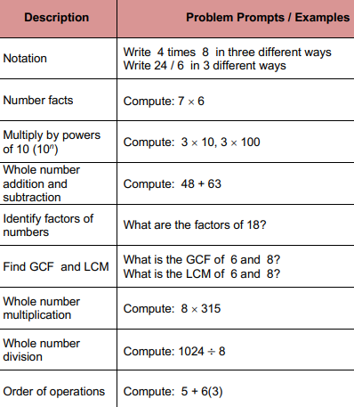
SKILLS PRACTICE WITH “SKILL BOOSTERS”
Example
You have 7th or 8th graders
in intervention
you’re concentrating on
integer operations,
solving equations,
etc.
Notes:
Let’s go back to when we showed that it’s common for intervention topics to stay somewhat close to grade level topics.
That’s just a reality in some places, a requirement for some intervention teachers. So let’s say you have 7th or 8th graders and you’re concentrating on topics closer to their grade level BUT they really need review and practice with everything, including whole numbers.
This is why we created Skill Boosters for several topics. Skill Boosters are a routine,meant to be done in 5-10 minute chunks per day for far below grade level work. You don’t get into the same detail or depth as you would in a series of lessons,
but the research suggests this is a useful strategy, and many of our users agree.
Here are some whole number examples

Slide 46
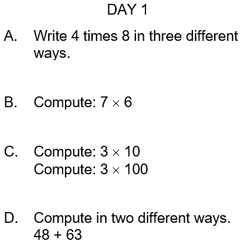
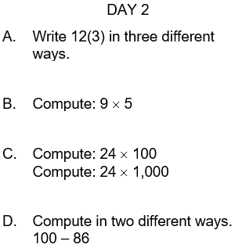
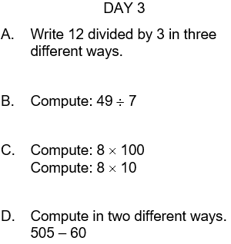
SKILL BOOSTERS EXAMPLES
Notes:
And this is how it might play out from day to day.
In short bursts students do similar problems over the course of a few days, or a few weeks, or however long you feel is necessary.

Slide 47
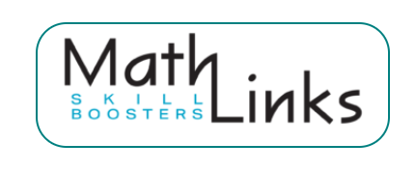
ALSO AVAILABLE…
Whole Numbers
Fraction Concepts
Fraction Addition and Subtraction
Fraction Multiplication and Division
Decimal and Percent Concepts
Integers
Equations
A daily routine
About 5-10 minutes per day
Notes:
Here are all of the Skill Booster topics we provide to use as you see fit.

Slide 48
THE MathLinks: ESSENTIALS PROGRAM
Modules | Pkt 1 Gr levels | Pkt 2 Gr levels | Pkt 3 Gr levels
Number Base 10 | 4-6 | 4-5 | 5-6
Fractions | 3-4 | 4-5 | 5-6
Proportional Reasoning | 6 | 6-7 | 7
Integers | 6 | 7 | 7
Expressions & Equations | 6 | 7 | 8
Functions | 8 | 8 | 8
Grade 4-6
Foundational work
Grade 6-8
Major work
Notes:
Remember that if you decide to use MathLinks Essentials, YOU choose whatever content you think is the most helpful for your students, as much or as little as you want. AND, everything is right there for you. All you need to do is look things over and decide how you want instruction to play out.

Slide 49
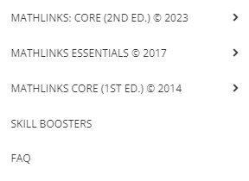
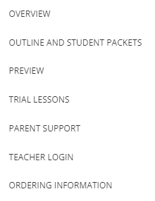
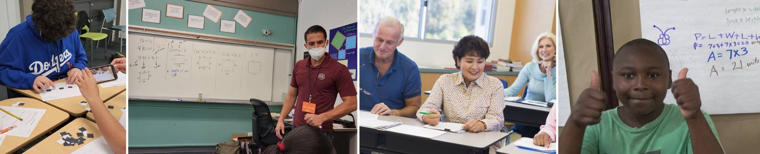

CHECK OUT THE PROGRAM
www.mathandteaching.org
Notes:
If you’d like to check out our program further, just go to our website and look under curriculum.
Click on Essentials and Overview to get a quick glimpse of some checklists and problem sets that give you a feel for the content of the packets or click on Student Packets to preview any of the student packets in full.

Slide 50

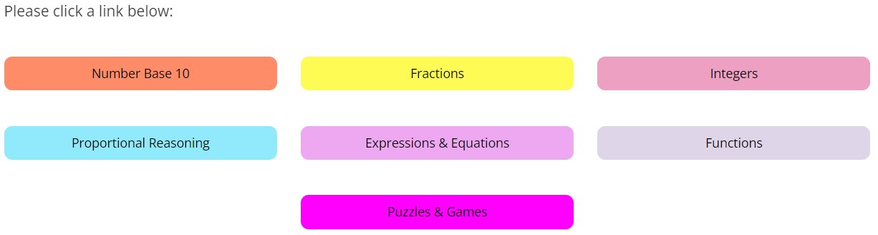

THE TEACHER PORTAL
BONUS
Secure
password-protected
access for teachers
Notes:
Everything is housed on our secure teacher portal, and these great books full of math puzzles and games are a free bonus as well. If you want to take a closer look, please contact us.

Slide 51
CONTACT US
The Center for Mathematics and Teaching
Non-profit 501(c)(3)
www.mathandteaching.org/essentials/
Mark Goldstein
mark@mathandteaching.org
THANK YOU!!
Notes:
Thank you for viewing this presentation. If you have any question, please feel free to contact us.

