Slide 1
CONTENT FOR CATCHING UP
Mark Goldstein
mark@mathandteaching.org
Cynthia Raff
cynthia@mathandteaching.org
The Center for Mathematics and Teaching [a 501(c)(3) non-profit]
www.mathandteaching.org/essentials/
Notes:
Welcome to our presentation on MathLinks: Essentials – Integers.
If you don’t know us…CMAT is a non-profit and we develop middle school mathematics curriculum and resources, and support teachers in using them through professional development.
We worked together in the mathematics department at UCLA for about a decade.
Then about 14 years ago we left the university to form CMAT.

Slide 2
AGENDA
An Basic Intervention Plan
Experiences and Research
Integer content
source: the MathLinks Essentials Integers module
Notes:
Agenda for what will be covered in this presentation.

Slide 3

OUR EXPERIENCES
Plan to get students back on track
Major topics of middle school
Try to stay close to grade level
Backfill / Frontload
Appropriate content - pitched to students’ needs
High Expectations
Increase confidence and success
Notes:
Here’s what we’ve learned about getting students back on track from those that tell us that they’re having some success, and what’s important to their plan.
Focus on the major work of the grade bands you’re working with. You can’t do it all in the time you have,
so get the most bang for your buck.
Most choose to – or are told to – stay as close to their grade level as possible.
Most folks choose to backfill topics to fill in those gaps.
However, some mix in a little frontloading to give students a good foundation for a topic
before they see it in their core class. Teachers report that when they do this, their students feel really confident on a new topic.
You need to find appropriate materials. If you’re going to have a systematic plan, you have to know all of your topics and find all your materials well ahead of when you intend to teach them.
Most of our intervention students can do the work, but they learn differently, and may need different strategies and supports. Students that struggle crave meaning to attach to concepts in order to have success.
Everyone’s goal is to increase confidence and bolster students’ chances for success

Slide 4
WHAT THE RESEARCH TELLS US
Ongoing Formative Assessment and Feedback
Teacher Support
Do we need to test our struggling learners a lot?
How can we support teachers in this work?
Alternate Strategies
Balance Basic Skills and Conceptual Development
Must students know more than one strategy?
If Basic Skills AND
Conceptual Development
are both important,
how do you pull that off?
Rehearsal
What’s the right kind
of practice and
how much is the right amount?
Notes:
And though we’ve had years of experience, we also consulted the research.
We’re not suggesting to test our intervention students a lot. They need more frequent feedback and guidance than students who have had more success.
We don’t recommend peppering students with a bunch of strategies, but offering more than one,
and then helping them pick the one that they like, is really beneficial.
The right amount of practice could be different from student to student. Teachers know their students best, so it’s nice to offer options. When students are practicing, make sure they have a good shot at getting the problems right.
We’ll give plenty of examples where you can start with concepts, make them reasonable, and guide students to the rules and procedures. It’s important for ALL learners to get that kind of instruction, but it’s especially important for struggling learners. Since memorization may not be their strong suit, they crave meaning and connections for things to make sense.
And of course, teachers need support and materials that are complete and easy to use.

Slide 5
GRADES 6-7 CONTENT
Today’s content focus:
Integer concepts from grade 6
Integer operations from grade 7
Note: we leave non-integer rational numbers to the core course
Supports major middle school number and algebra learning goals
Notes:
The focus of this presentation is on integer concepts and operations. These topics are from grades 6 and 7.
Operating on non-integer rationals is important, but our goal at first is to make sure our students get the concepts down on integers. If you throw in negative fractions and decimals too soon, it could cause some unwanted problems.

Slide 6

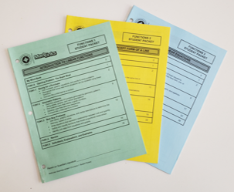
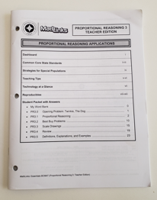
TODAY’S SOURCE MATERIALS
Student Packets
Teacher Edition
Notes:
The content ideas are from our MathLinks Essentials modules, written specifically for intervention purposes.
Here you see 3 consumable student packets
and a teacher edition for one of our modules,
like this one on integers we’ll be using.

Slide 7
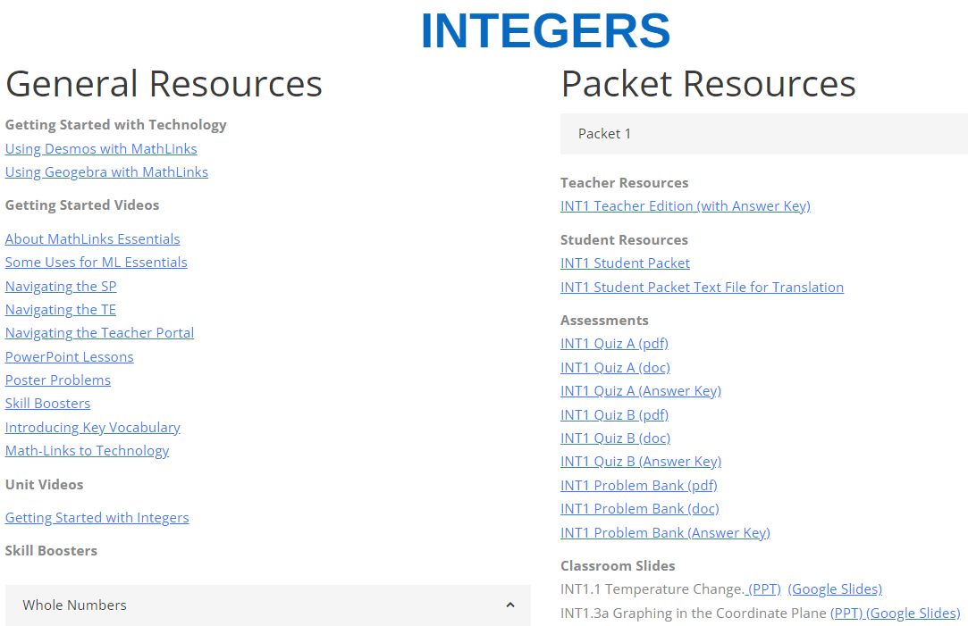
TODAY’S SOURCE MATERIALS
Teacher Portal – Online Resources
Notes:
Additionally, we’ll be pulling content from our teacher portal, which has several components that support teachers in the work beyond just the TE.
For example, you’ll see several individual slides taken from slide decks that some of our teachers use to deliver instruction.
I hope they give you some good ideas about how to reach students on this topic.

Slide 8
MathLinks: INT MODULE
INTEGERS
First Unit: “Packet 1”
Introduction to Integers
Notes:
Here’s the first unit, which we call packet 1, Introduction to Integers.

Slide 9
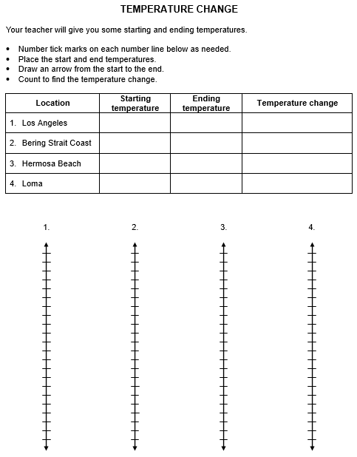
STUDENT PAGES: CONCEPT DEVELOPMENT
Notes:
Temperature change is a simple context for students to start to make sense of this topic, and the number line is a common tool for getting to know positive and negative numbers.
Note the open and inviting work space to support struggling learners.

Slide 10

DELIVERING INSTRUCTION
At 3:00 AM, the temperature on the Bering Strait Coast in Alaska was -10°F. At 3:00 PM, the temperature was 5°F.
Did the temperature increase or decrease from the AM till the PM?
How do we want to scale the number line?
(2) Using a number line, find the
temperature change using an arrow diagram and fill in the table.
Notes:
This is one of the slides for this part of the lesson.
We want students to have classroom discussions to make sense of things, and also to write their answers, thoughts, and conclusions in their work space

Slide 11
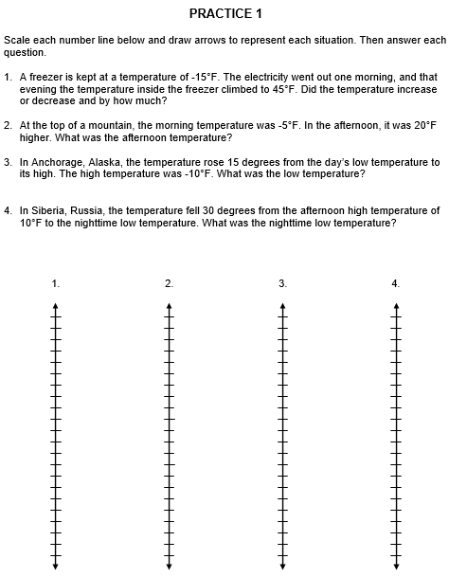
STUDENT PAGES: PRACTICE
Notes:
Rehearsal is important, and so make sure to offer frequent opportunities to practice after developing a concept.

Slide 12
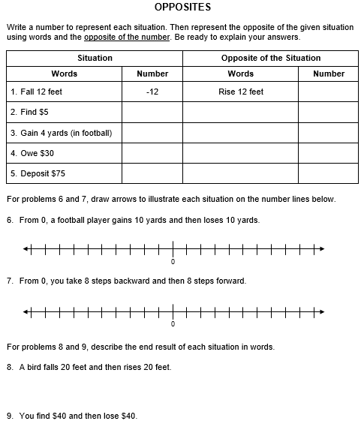
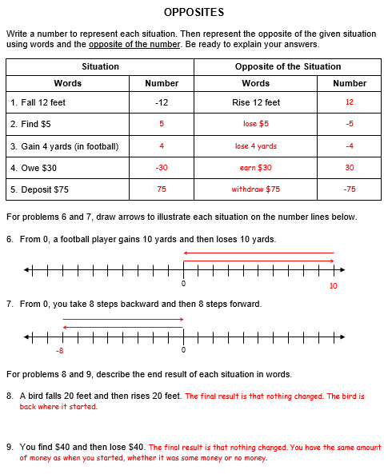
STUDENT PAGES WITH TE AK’s
Notes:
Here’s a page that gets at the idea of opposites.
Taking a quick look, you’ll notice that it’s straightforward and should make sense to your students.
Our teachers appreciate that we offer answers keys, because students need immediate feedback.

Slide 13

CREATING THE NEED TO KNOW
Without saying anything pick any dot.
Describe its location in writing as if you were trying to help someone in class find it.
Notes:
Many middle school students loss interest easily if you don’t create the need to know. It doesn’t always have to be real life or fun, but it did have to be interesting or engaging in some way.
You might notice right away how inefficient this starts. Your students will too. It’s on purpose.

Slide 14
MIX IN LANGUAGE DEVELOPMENT
Find your SAME dot.
Each line is called an axis.
The plural is axes.
On a graph we call these
dots points.
Write a new description based on the added axes.
How did adding axes make writing a description easier?
Notes:
We keep going. By the way, our students might need some vocabulary reminders right about now.
Think about how your description might change, now that you have a new feature – the axes.

Slide 15

DISCUSSION CONTINUES
Find your SAME point.
Write a new description based on the added grid.
How did adding a grid make writing a description easier?
Notes:
As we continue. Think again about how your description might change, now that you have another new feature – grid lines.

Slide 16

COORDINATE PLANES MAKE SENSE
Find your SAME point.
Write a new description based on the added letters to name each point.
A
B
C
E
G
D
F
H
J
I
K
L
P
M
O
R
N
Q
T
How did adding “names” to each point make writing a description easier?
S
U
V
Y
W
Z
X
Notes:
And to conclude, we see how efficient our coordinate graphing system can be.

Slide 17
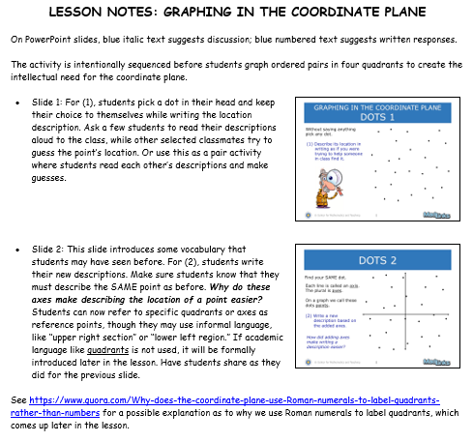
TEACHER SUPPORT
Notes:
Here is another way we like to support our teachers.
Along with the slide decks, we provide brief lesson notes to help with preparing to deliver instruction

Slide 18
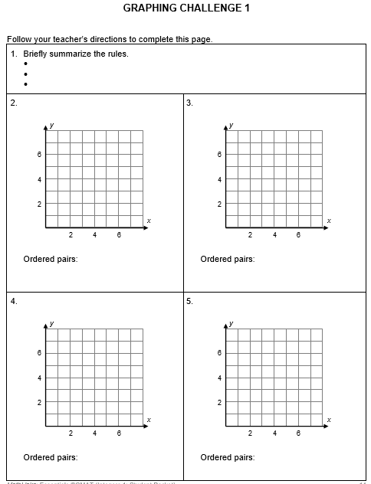
PROBLEM SOLVING / PRACTICE
x is a factor of 8
y < 5 AND y is prime
x-values:
y-values:
1, 2, 4, 8
2, 3
3
2
1 2 4 8
Notes:
We need to have high expectations for all of our learners?
This page is an example of a unique way to practice
graphing coordinates.
We think this is a nice challenge and great practice that also gets to reviewing vocabulary like factors and primes,
and notation like the less than sign.

Slide 19
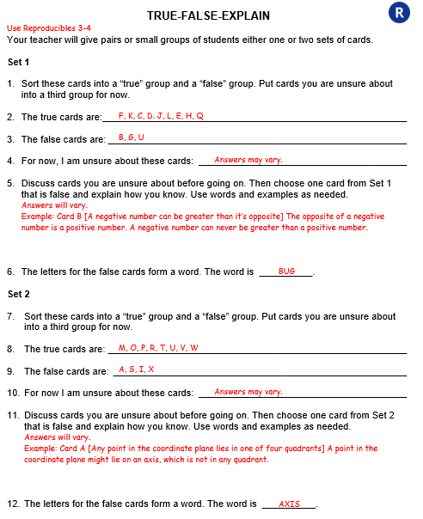
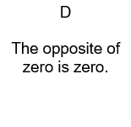
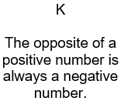
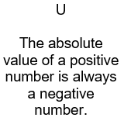
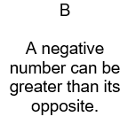
COLLABORATIVE REVIEW
TRUE CARDS
FALSE CARDS
Notes:
We think that students should have plenty of opportunities to collaborate and talk about the mathematics they’re learning.
After the 3 lessons in our student packets conclude, we have a review section that has activities that are usually for partner work.
Here you see a student page – that happens to have its answers. Students get cards that look like this to discuss and figure out whether they’re true or false statements, and also to explain some of their thinking.

Slide 20
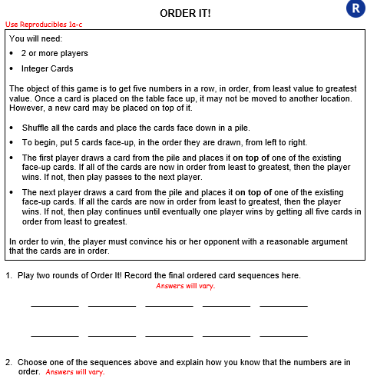
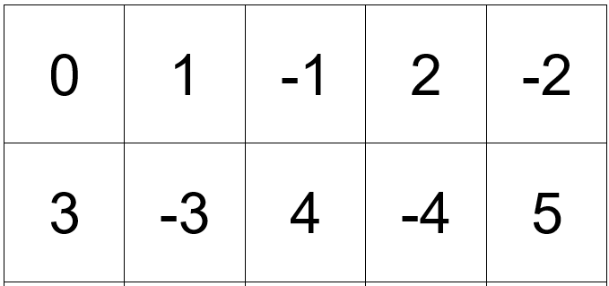
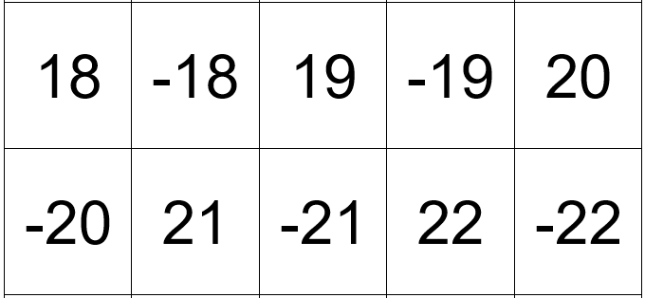
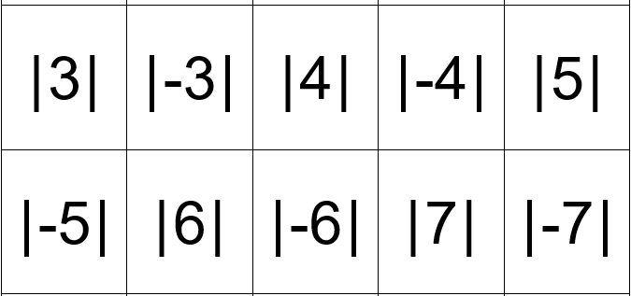
GAMES AND PUZZLES FOR REVIEW
Notes:
Additionally we think that games and puzzles are great ways to practice.
This is a card ordering game, and a sample of just some of the cards we provide, which are cut up prior to playing.

Slide 21
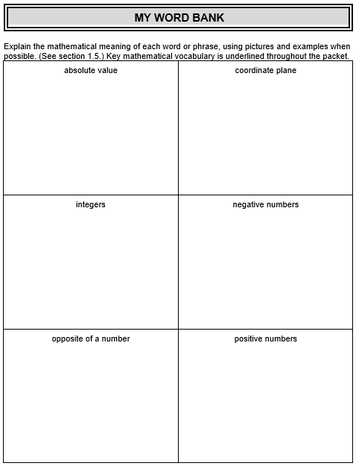
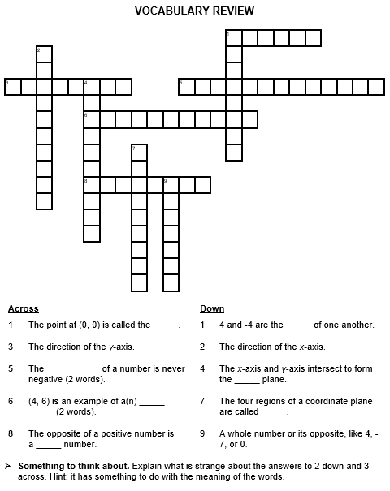
VOCABULARY SUPPORT
Notes:
Vocabulary is important. We provide a page (My Word Bank) like this at the start of every packet.
It’s important to address vocabulary in context. When a word comes up, at some point the teacher needs to go to
the precise definition and help students unpack it, and then help guide them to write something that’s meaningful, whether it’s something in their own words, an example, a picture…
And later in the unit
we offer more practice via a vocabulary review page.

Slide 22
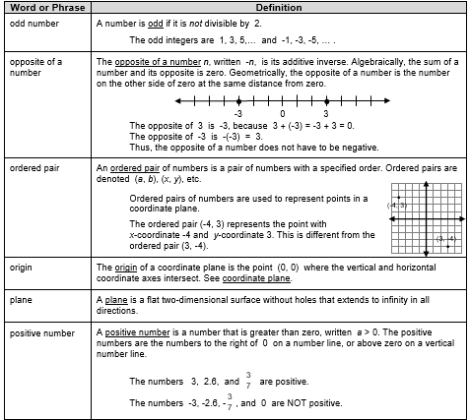
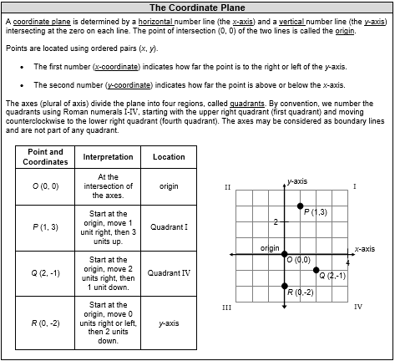
STUDENT RESOURCE SECTION
Notes:
At the end our packets we have the precise definitions and also examples and explanations.

Slide 23
STUDENT SUCCESS
Structure
Concept development
Skills practice (including games for motivation)
Creating a need to know
Problem solving
Vocabulary
Plenty of examples
Notes:
Here’s a list of things that we think are important for student success, and hopefully you saw them and that they resonated with you in some way.

Slide 24
MathLinks: INT MODULE
INTEGERS
Second Unit: “Packet 2”
Addition and Subtraction
Notes:
The second packet covers Integer Addition and Subtraction.

Slide 25



INTRODUCTION TO MAGIC HOT AND COLD CUBES
Place 1 cold cube in a liquid.
It decreases the temperature by 1 degree.
Place 1 hot cube in a liquid.
It gets hotter in the same way.
Putting cold in makes the liquid _____.
Putting hot in makes the liquid _____.
(1) What happens to a liquid when you put in 2 cold cubes?
(2) What happens to a liquid when you put in 3 hot cubes?
Notes:
Magic hot and cold cubes? What are they?
You put a cold one in a liquid and the temperature goes down a degree.
You put a hot one in the liquid and the temperature goes up a degree.
Put in colds and it gets colder.
Put in hots and it get hotter.

Slide 26
INTRODUCTION TO MAGIC HOT AND COLD CUBES
Removing 1 cold cube from a liquid
increases its temperature by 1 degree.
Remove 1 hot cube from a liquid.
It gets colder in the same way.
Removing cold makes the liquid _____.
Removing hot makes the liquid _____.
(3) What happens to a liquid when you take out 2 cold cubes?
(4) What happens to a liquid when you take out 4 hot cubes?
Notes:
You take a cold one out and the temperature goes up a degree.
You take a hot one out and the temperature goes down a degree.
Take out colds and it gets hotter.
Take out hots and it gets colder.
With these two simple slides, students seem to get right away. Now, they’re ready to tackle adding and subtracting integers.

Slide 27
A COUNTER MODEL
This is a positive counter.
Record: +
This is a negative counter.
Record: –
+
This is a zero pair.
Record: + – or
–
Notes:
To go with the intuitive context, we include a manipulative also, because many students are visual and tactile.
Make sure that they really get the idea of a zero pair, because it’s going to be important as the model progresses.

Slide 28
BUILD -3
Build -3 in three different ways.
Think -3 + 0
Think -3 + 0 + 0 + 0
Notes:
Students get plenty of practice building numbers in different ways.
-3 can be built very simply, but it can also be built in other ways using the idea of zero pairs.
This will be absolutely necessary for doing some operations.

Slide 29
ADDING INTEGERS WITH COUNTERS
4 + (-3)
= 1
Start with workspace equal to 0
“ADD” OR
“PUT ON WORKSPACE”
REMOVE
ZERO PAIRS
Notes:
Let’s try adding:
We always start with a workspace equal to zero,
then we can build 4.
The plus sign means we put more on the workspace.
Here we put on our workspace, -3.
We remove the zero pairs.
There’s clearly a result of 1.

Slide 30
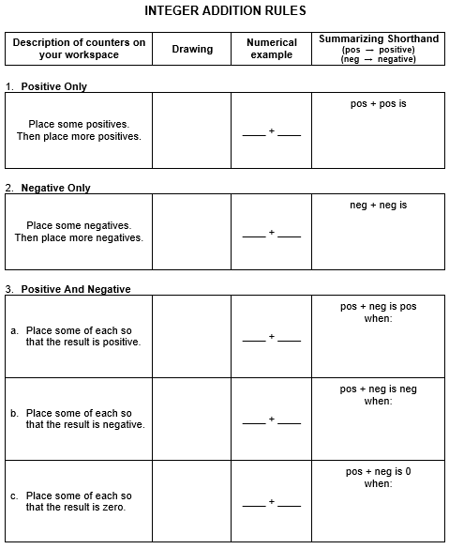
STUDENT PAGES: THE RULES
Notes:
Students do plenty of examples and practice, and then at some point we ask THEM what the rules are, case by case.
It’s so much more powerful when they tell you the rules!
Along the way, at any time we can bring back hot and cold cubes…
Putting in hots made things hotter - adding a positive,
And putting in colds made things colder – adding a negative.

Slide 31
SUBTRACTING INTEGERS WITH COUNTERS
-4 – (-3)
= -1
Start with workspace equal to 0
“SUBTRACT” OR
“REMOVE FROM
WORKSPACE”
I have enough to take away.
Notes:
On to a couple subtraction examples.
This one’s pretty straightforward.
We always start with a workspace equal to zero, then we can build -4.
The subtraction sign means we remove from the workspace.
Since there’s enough to take away, you take away 3 negatives and the result is -1.

Slide 32
SUBTRACTING INTEGERS WITH COUNTERS
2 – (-5)
= 7
Start with workspace equal to 0
“SUBTRACT” OR
“REMOVE FROM
WORKSPACE”
ADD
ZERO PAIRS
I don’t have what
I need to take away.
What now?
Notes:
This one’s trickier.
We start with our workspace equal to zero, then we build 2.
The subtraction sign means we remove from the workspace.
There’s definitely not any negatives to take away, so at this point students may be stumped….
BUT rather than telling them what to do, ask if there are ways to build 2 other than what they see…
and there’s ALWAYS someone who blurts out “oh, zero pairs”
Add some zero pairs until you can take away -5 and the result is 7.

Slide 33
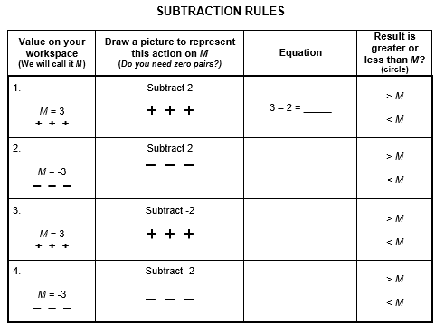
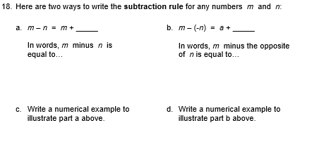
STUDENT PAGES: THE RULES
Notes:
Like before, plenty of time is spent practicing with lots of examples, until it’s time to extract the rules.
We see that subtracting 2, for example, always results in a decrease of the starting value…
While subtracting -2, for example, always results in an increase of the starting value.
And we can always go back to the hot and cold cubes…
Taking out hot resulted in the temp going down – subtracting a positive makes lower,
and taking out colds resulted in the temp going up – subtracting a negative makes higher,
The models support each other!

Slide 34
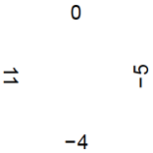
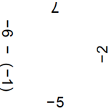
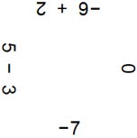
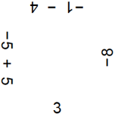
BIG SQUARE PUZZLE FOR REVIEW
Notes:
We like to try to make the practice more fun. Here are some pieces form what we call a big square puzzle
We see that these expressions match up…

Slide 35
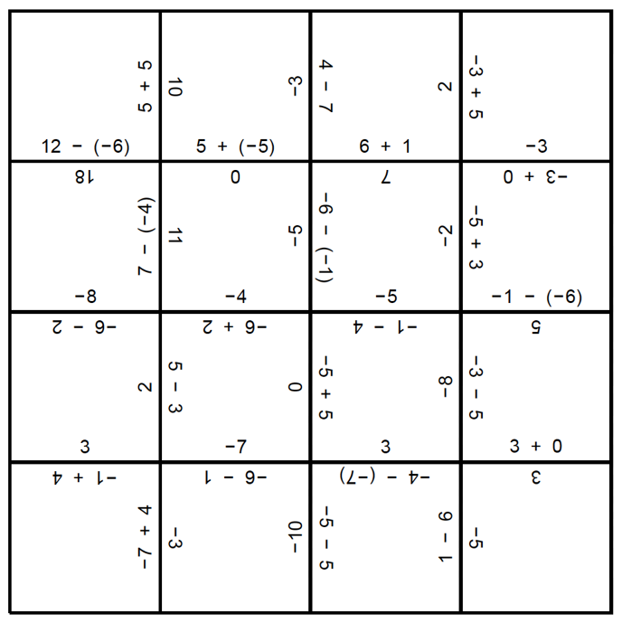
FINISHED PRODUCT
Notes:
And this is the finished product using all 16 little squares.

Slide 36
MathLinks: NBT MODULE
INTEGERS
Third Unit: “Packet 3”
Multiplication and Division
Notes:
Packet 3, addresses Integer Multiplication and Division.

Slide 37
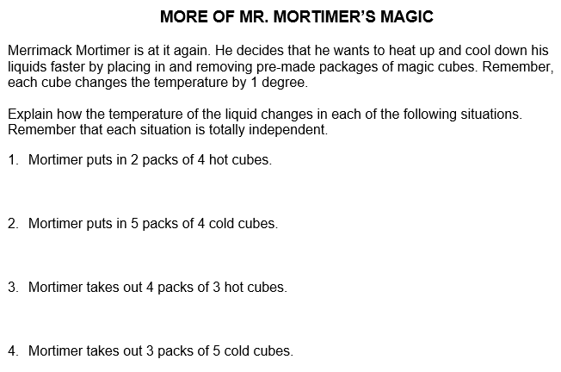
REVISITING A CONTEXT
increase temp
multiplication
related to
addition…
decrease temp
decrease temp
…and to
subtraction
increase temp
Notes:
We revisit Mortimer and relate multiplication to addition by putting in GROUPS of cubes, and to subtraction by taking out GROUPS of cubes. It makes sense because increasing temperatures comes from putting in hots and taking out colds, while decreasing temperatures happens when we put in colds and take out hots.

Slide 38
MULTIPLYING INTEGERS WITH COUNTERS
2 • (-3)
= -6
Put 2
groups on
workspace.
Start with workspace equal to 0
Notes:
Now a couple multiplication examples. This is the straightforward one.
We always start with a workspace equal to zero.
The first number means we put 2 groups on the workspace and we can clearly put 2 groups of 3 negatives down
to result in -6.
We put in groups of colds and it got colder. That makes sense!

Slide 39
MULTIPLYING INTEGERS WITH COUNTERS
-2 • (-3)
= 6
Start with workspace equal to 0.
The opposite of putting 2 groups in…
…must be removing 2
groups from the
workspace.
Now there are 2 groups of 3 negative counters to remove.
Since there are no negative counters to remove, add some zero pairs.
There’s nothing to take away.
Notes:
This is the trickier one.
It stands to reason that on the previous slide we put 2 groups down, and here we must do the opposite,
namely removing 2 groups.
On a previous slide, we saw something similar where we wanted to remove something, but nothing was there to remove. Ask about it and students will tell you to put some zero pairs down. Put down as many or as few as you want until you have at least 2 groups of -3 to remove. The result is 6.
We removed groups of colds and it got hotter. That makes sense!

Slide 40
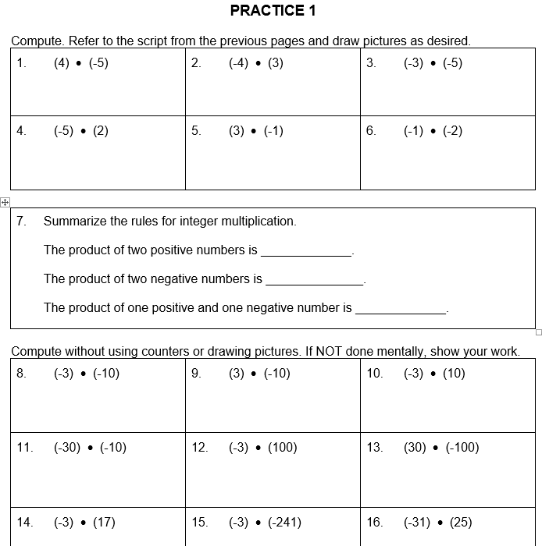
STUDENT PAGES: THE RULES
Notes:
After plenty of examples and practice, students again tell us the rules…

Slide 41
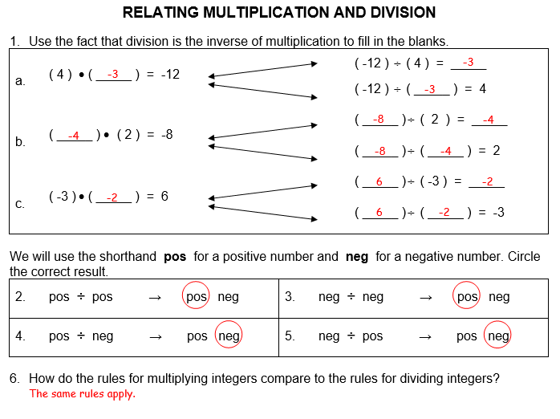
DIVISION (from the TE)
Notes:
And we finish up with division.
Exploring division with counters is really fun, and maybe a little frustrating too, because if you explore you find that every division case works with the model, except dividing a positive by a negative.
Go ahead and do this with your students if they’re interested, but we decide to cut to the chase and just have students use multiplication facts to derive division facts, and the rules pop out very quickly.
As an aside, this is no reason to criticize the model. They all break down at some point. And the goal anyway is to create understanding and then move away from it to the rules.

Slide 42
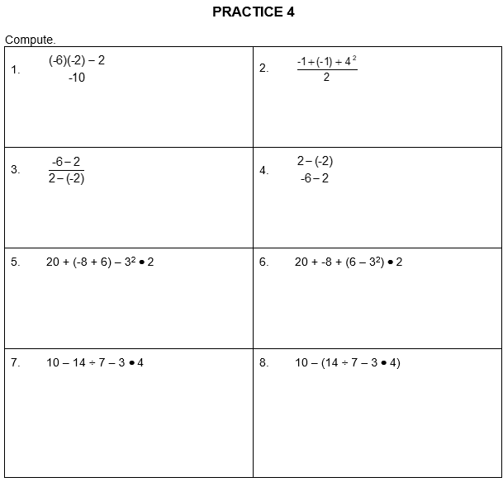
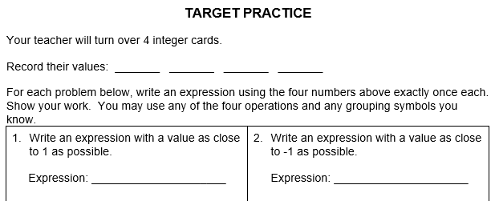
REVISIT ORDER OF OPERATIONS
Notes:
Here’s some practice with all 4 operations while we revisit the order of operations conventions and as is common, we like to use games for practice frequently.

Slide 43
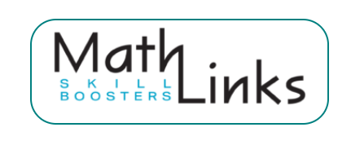
ALSO AVAILABLE (for free)…
Whole Numbers
Fraction Concepts
Fraction Addition and Subtraction
Fraction Multiplication and Division
Decimal and Percent Concepts
Integers
Equations
A daily routine
About 5-10 minutes per day
Notes:
Early on we discussed how intervention topics should try to stay close to current grade level topics.
Again, you don’t have to do that, but the more people we talk to, it seems to be the more common way to go.
Let’s say you’re working with 8th graders, doing a pretty deep dive into integers and solving equations, but you KNOW that students need support with others things like fractions.
That’s why we put together skill boosters. They don’t relate to any of our units. What they are is a skills practice routine that anyone can do in daily 5 to 10 minute chunks.
The goal is to chip away at topics far below grade level that you’re not working on more intensely.

Slide 44
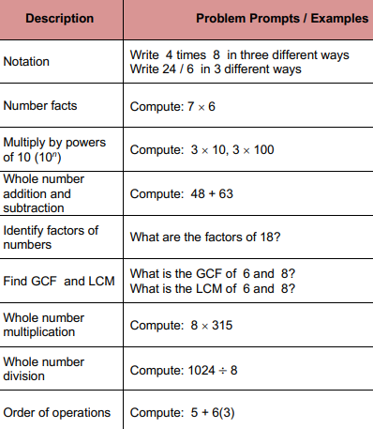
SKILLS PRACTICE WITH “SKILL BOOSTERS”
Example
You have 7th or 8th graders
in intervention
you’re concentrating on
integer operations,
solving equations,
etc.
Notes:
If you decided on using this strategy for whole number multiplication review, you’d just pick the skills you want your students to work on…

Slide 45
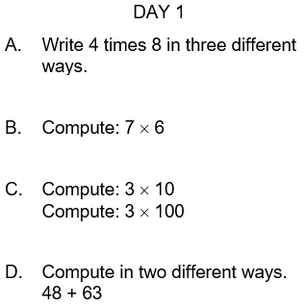
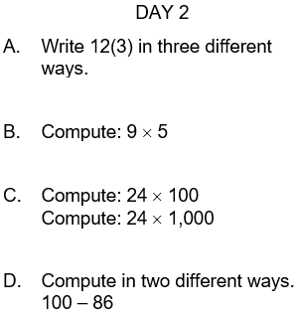
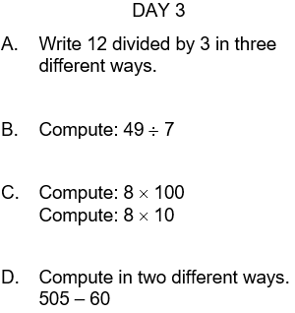
WHOLE NUMBER MULTIPLICATION EXAMPLES
Notes:
And give them small daily problem sets like these, over the course of several days or a few weeks.
You can do the same for fractions, decimals, or whatever.
Our teachers appreciate that this is all laid out for them.

Slide 46
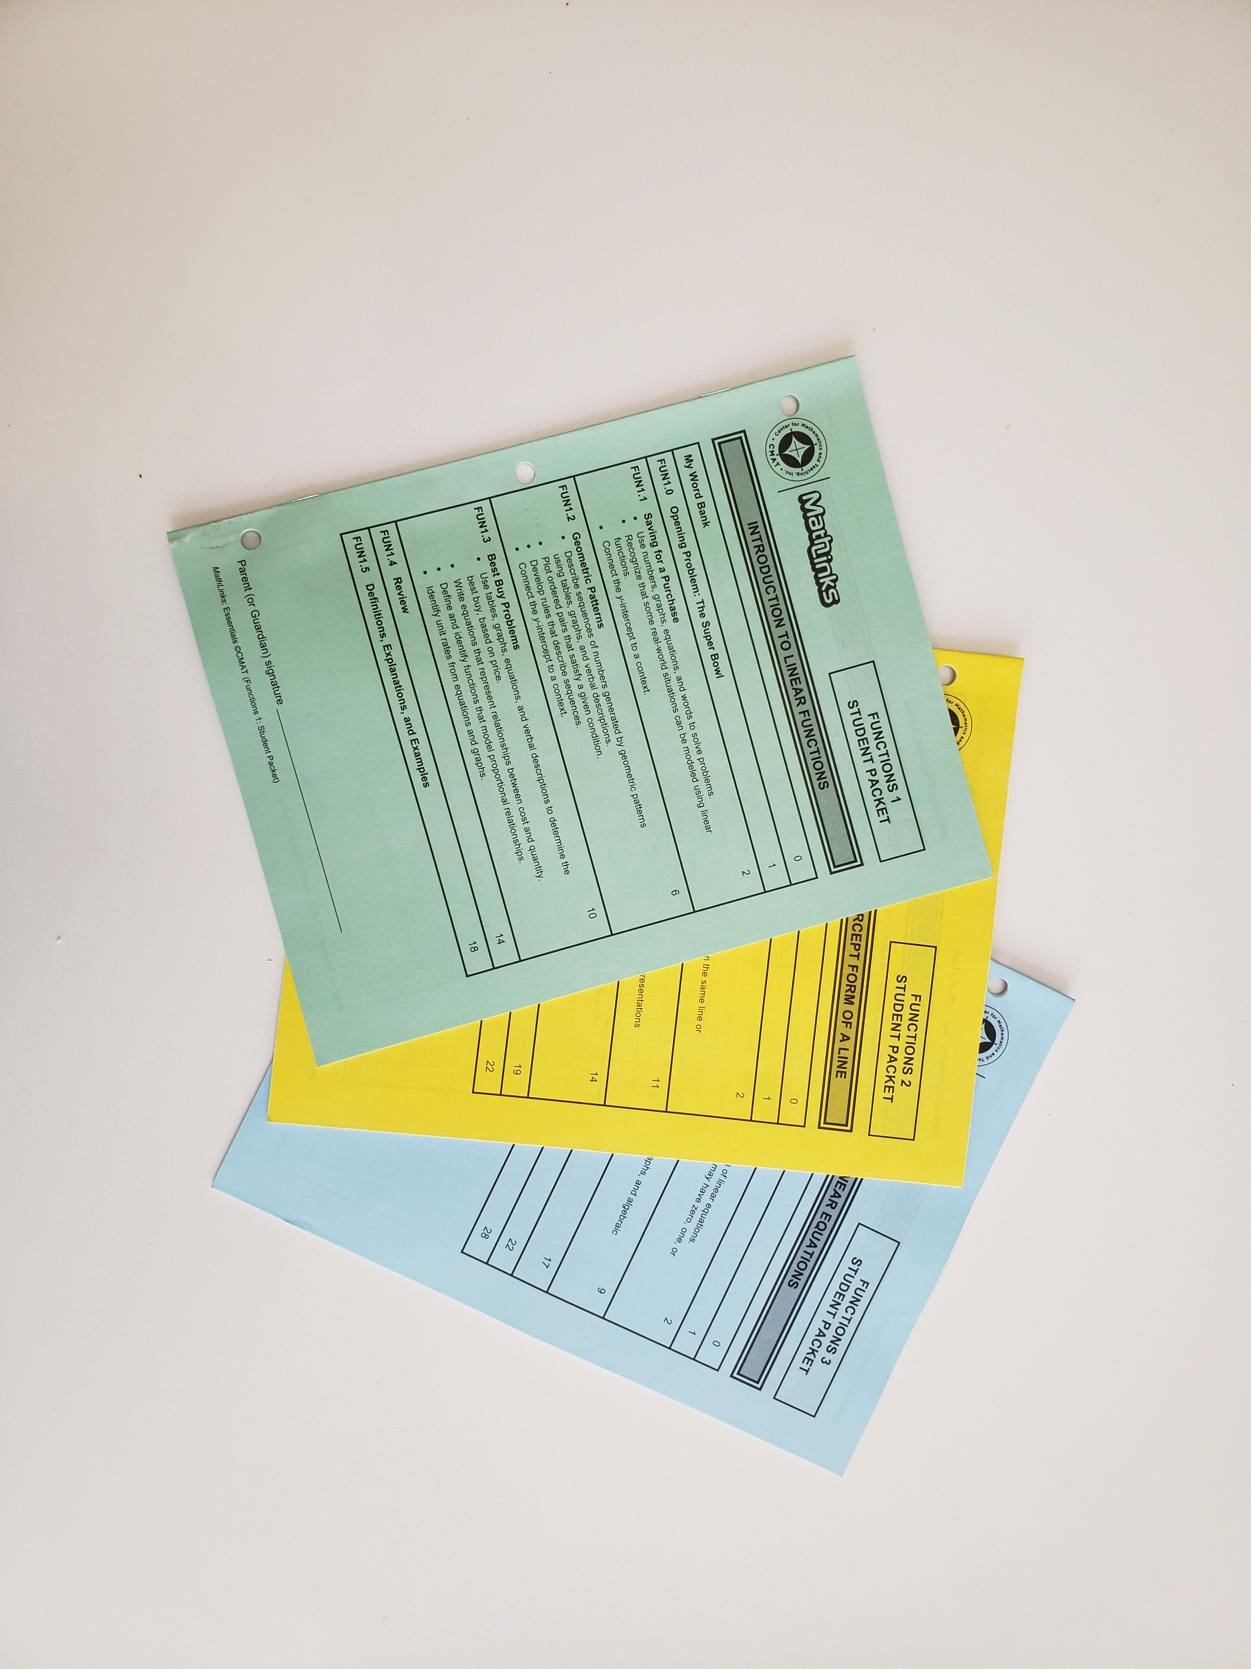
STUDENT PACKETS
Every packet includes:
An opening problem
Attention to vocabulary
Three multi-period lessons
Review activities
Definitions, explanations, and examples
Notes:
Here is what is included in the Student Packet, all of which you saw in this presentation.

Slide 47
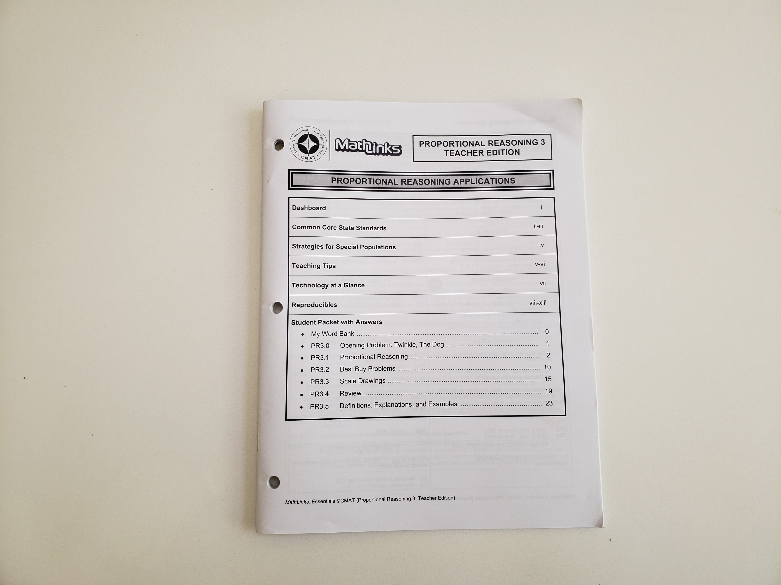
TEACHER EDITION
You’ll find:
Planning dashboard
Standards
Teaching notes
Tech activities
Reproducibles
Answer key
Lesson plans with
slide decks
Notes:
And what you find in the Teacher Edition.

Slide 48
THE MathLinks: ESSENTIALS PROGRAM
Modules | Pkt 1 Gr levels | Pkt 2 Gr levels | Pkt 3 Gr levels
Number Base 10 | 4-6 | 4-5 | 5-6
Fractions | 3-4 | 4-5 | 5-6
Integers | 6 | 7 | 7
Proportional Reasoning | 6 | 6-7 | 7
Expressions & Equations | 6 | 7 | 8
Functions | 8 | 8 | 8
Gr 4-6
Foundational work
Gr 6-8
Major work
Notes:
If you’re interested in our modules, here they are. All 6 modules have 3 student packets each.
Most of our users mix and match any of it to make the program that works for their students.
And they appreciate that everything they need is right there for them.

Slide 49
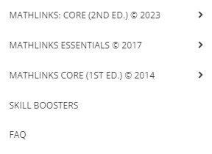
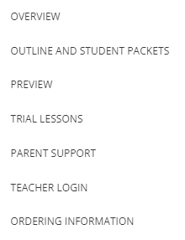
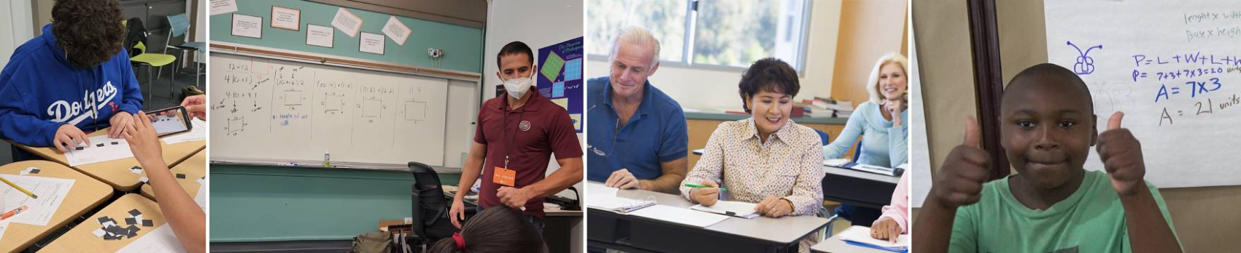
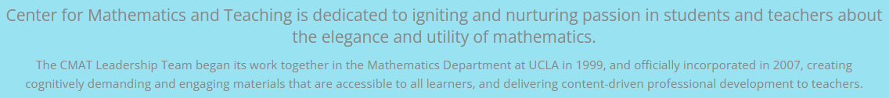
CHECK OUT THE PROGRAM
www.mathandteaching.org
Notes:
If you’d like to check out the program further, just go to our website and look under curriculum.
Click on Essentials and Overview to get a quick glimpse of some checklists and problem sets that give you a feel for the content of the packets, or click on Student Packets to preview any of the student packets in full.

Slide 50

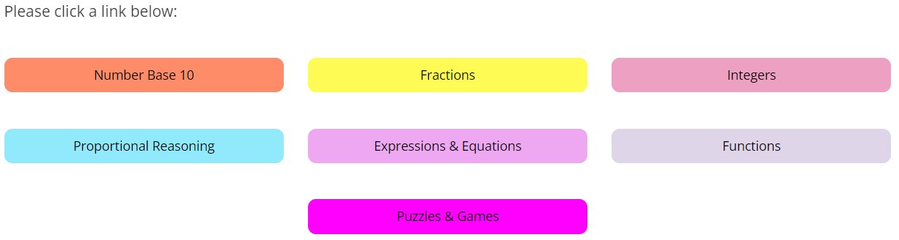
THE TEACHER PORTAL
BONUS
Notes:
Here’s the password protected teacher portal, where you’d find all the components for all of the modules.
Skill boosters are a free part of any module purchased and these books of games and puzzles come free too.
They’re not connected to any module, but provide lots of challenging and fun opportunities for all students.

Slide 51
CONTACT US
The Center for Mathematics and Teaching
Non-profit 501(c)(3)
www.mathandteaching.org/essentials/
Mark Goldstein
mark@mathandteaching.org
THANK YOU!!
Notes:
Thank you for viewing this presentation. If you have any question, please feel free to contact us.

