Slide 1
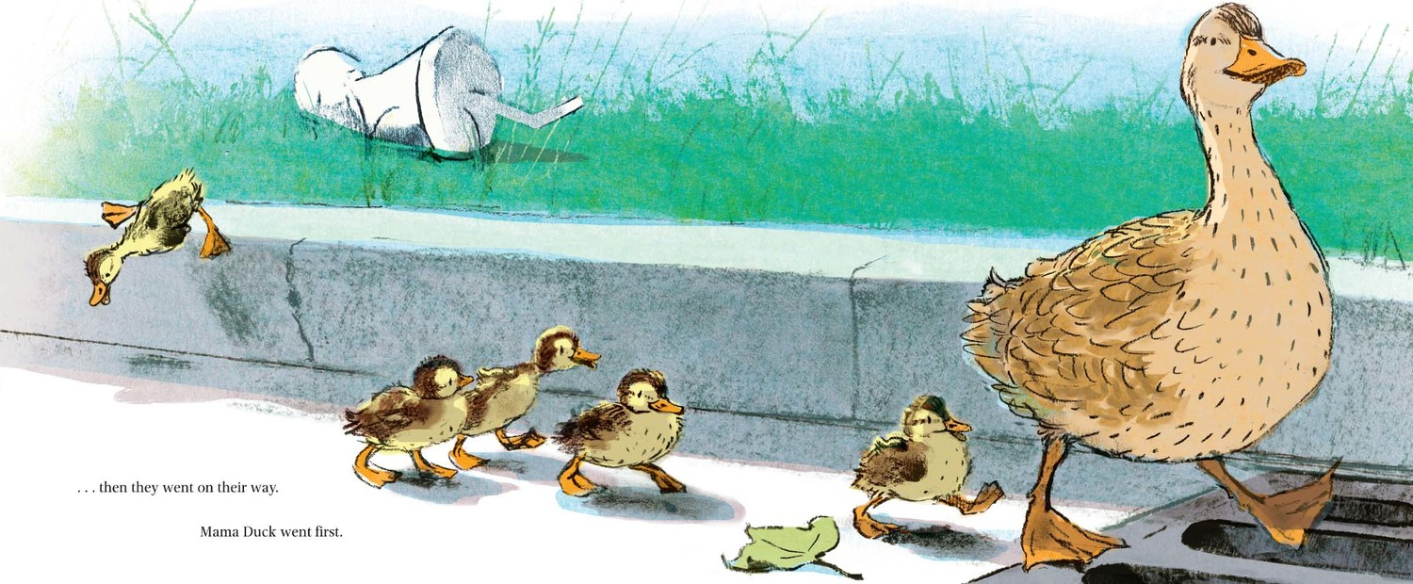
HELPING STUDENTS CATCH UP: FOCUS ON FRACTIONS
Shelley Kriegler
shelley@mathandteaching.org
The Center for Mathematics and Teaching [a 501(c)(3) non-profit]
www.mathandteaching.org/essentials/
Notes:
Welcome. Shelley Kriegler here, writing notes for you here. Feel free to contact me (shelley@mathandteaching.org) with feedback or questions.
This slide deck has strategies to help all the little duckies in your class get back on track with math.

Slide 2
AGENDA
Why Fractions?
Our Intervention Resources
Fraction Concepts
Fraction Subtraction
Fraction Division
Notes:
Agenda for this webinar. If you are interested in just one part, you can look for the big blue bar slide to fast forward.

Slide 3
WHY FRACTIONS?
1 3 4 8
Notes:
A look at a few examples using these numbers

Slide 4
WHY FRACTIONS?
Cynthia has a ribbon that is 3/4 of a yard. She wants to cut pieces that are 1/8 yard long. How many pieces can she cut?
1
2
3
4
5
6
WHY?
Notes:
Division – this problem could be done by counting lengths of 1/8 yard. Does the computation complicate the context?

Slide 5
WHY FRACTIONS?
Cynthia has a ribbon that is 3/4 a yard. She wants to cut pieces that are 1/8 yard long. How many pieces can she cut?
ALGEBRA?
NOW WHAT?
x = 6
Notes:
Another way to conceptualize the problem. This may make more sense as a setup, but will students struggle solving the equation?

Slide 6
WHY FRACTIONS?
Find the slope between the points (8,3) and (4, 1)
x
y
WHY NO COMMON DENOMINATOR??
Notes:
Students are taught to find a common denominator. Why not here?

Slide 7
OUR INTERVENTION RESOURCES
Notes:
All strategies and activities are drawn from our MathLinks Essentials program – an intervention program that focuses on the major work of middle school and elementary topics needed for success.

Slide 8
THE MathLinks: ESSENTIALS PROGRAM
Modules
Number Base 10
Fractions
Integers
Proportional Reasoning
Expressions & Equations
Functions
3
“units of study”
for each module
10-15
hours of instruction
Notes:
MathLinks Essentials six modules. This slide deck focuses on Fractions.

Slide 9

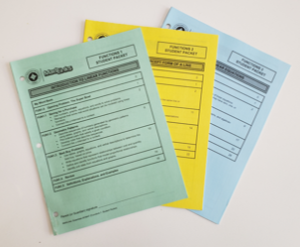
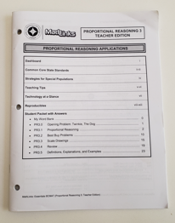
TODAY’S SOURCE MATERIALS
Student Packets
Teacher Edition
Notes:
Each module includes consumable student packets, printed Teacher Edition…

Slide 10
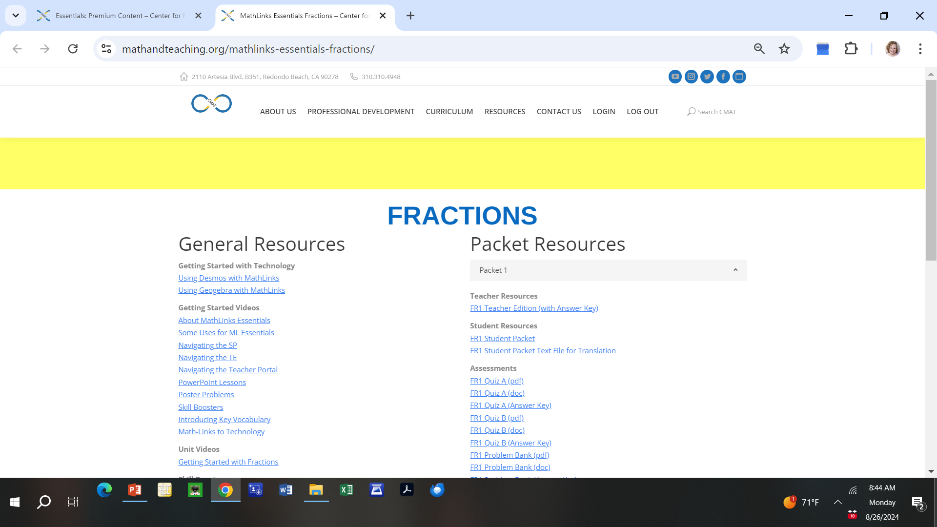
TODAY’S SOURCE MATERIALS
Teacher Portal – Online Resources
Notes:
And lots of resources online

Slide 11
TODAY’S SOURCE MATERIALS
Tier 2 Intervention (2nd period of math)
Special education courses
Summer programs
Backfill / Frontload
Notes:
Typical uses for the program. I personally think it is important to frontload whenever possible. Students will then have more confidence in grade level work when it comes up and their grades will go up. Just working on past skills is helpful, but it doesn’t necessarily translate into immediate higher grades.

Slide 12
FRACTION CONCEPTS
Notes:
Probably the biggest hole in student understanding is foundational fraction concepts.

Slide 13

CONCEPT DEVELOPMENT
Once upon a time…in my high school classroom…
THIRDS ??
This Photo by Unknown Author is licensed under CC BY
This Photo by Unknown Author is licensed under CC BY
Notes:
This actually occurred in my classroom. It made me rethink how to teach fractions.

Slide 14
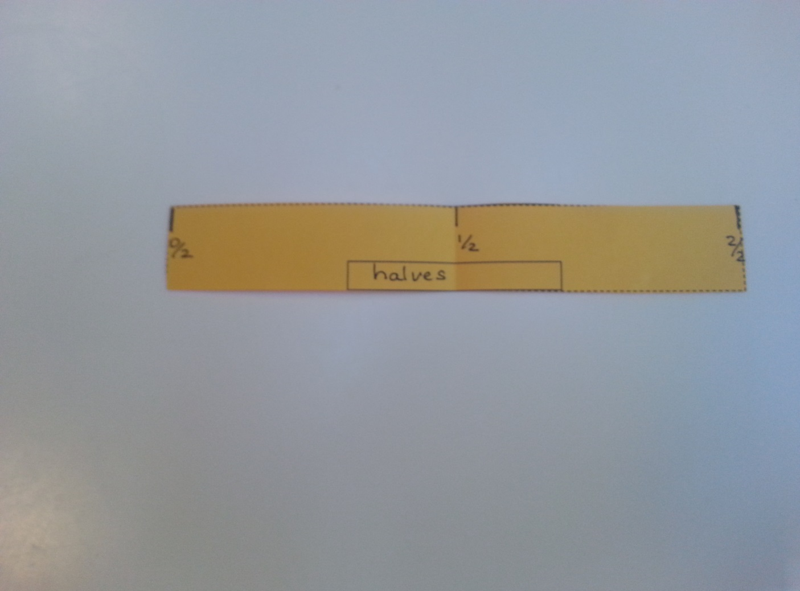
MAKING FRACTION STRIPS
0 and 1 at the edges
Label each strip
Notes:
I like the linear (ruler) model for fractions as a starting point. Students mark and fold different fractions strips

Slide 15
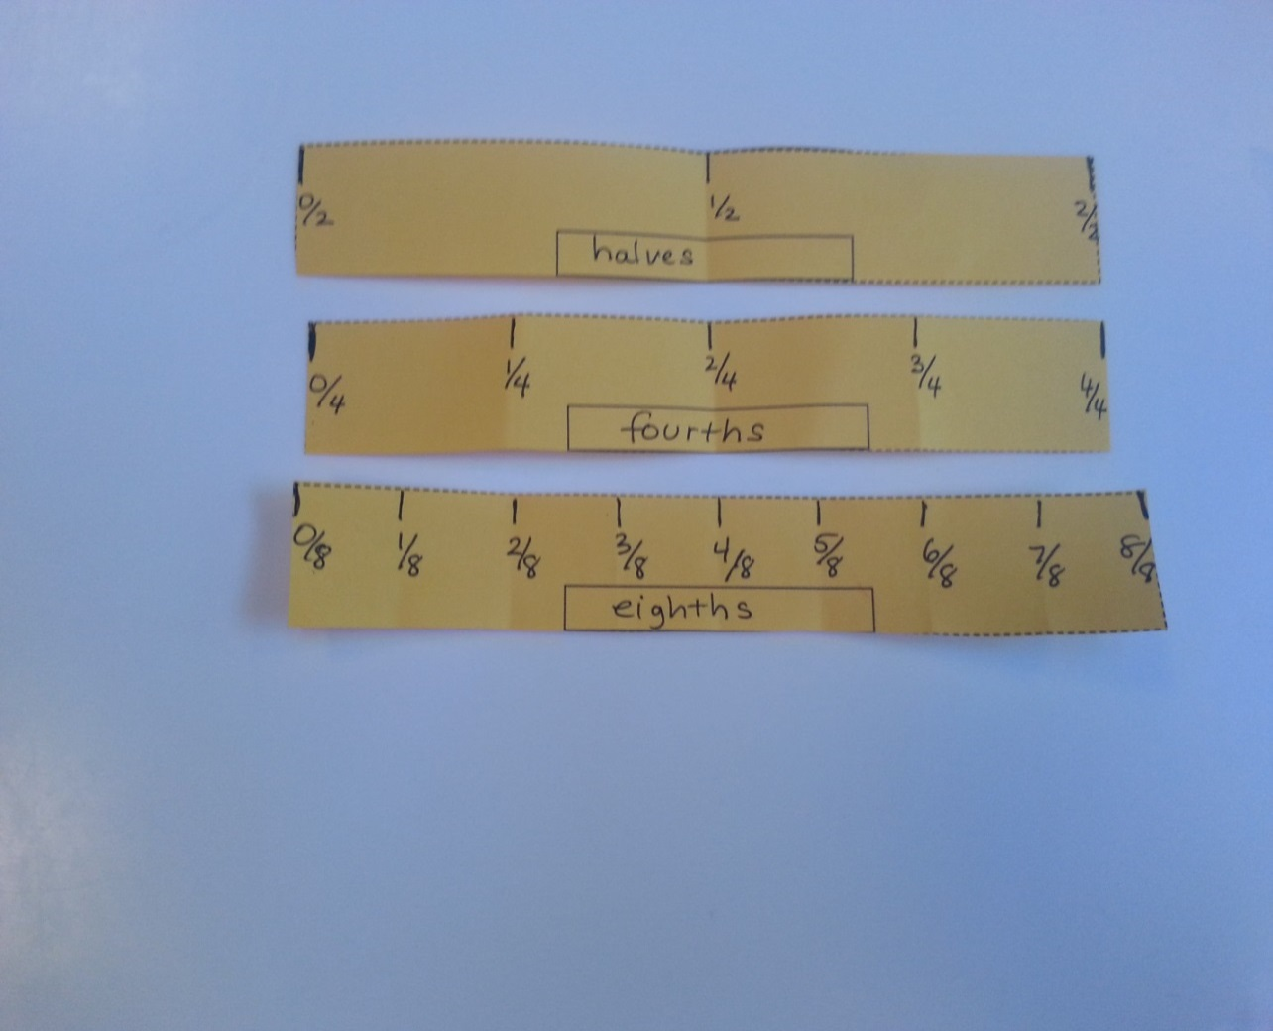
CREATING A FRACTION ARRAY
Notes:
Starting with halves, fourths, and eighths

Slide 16
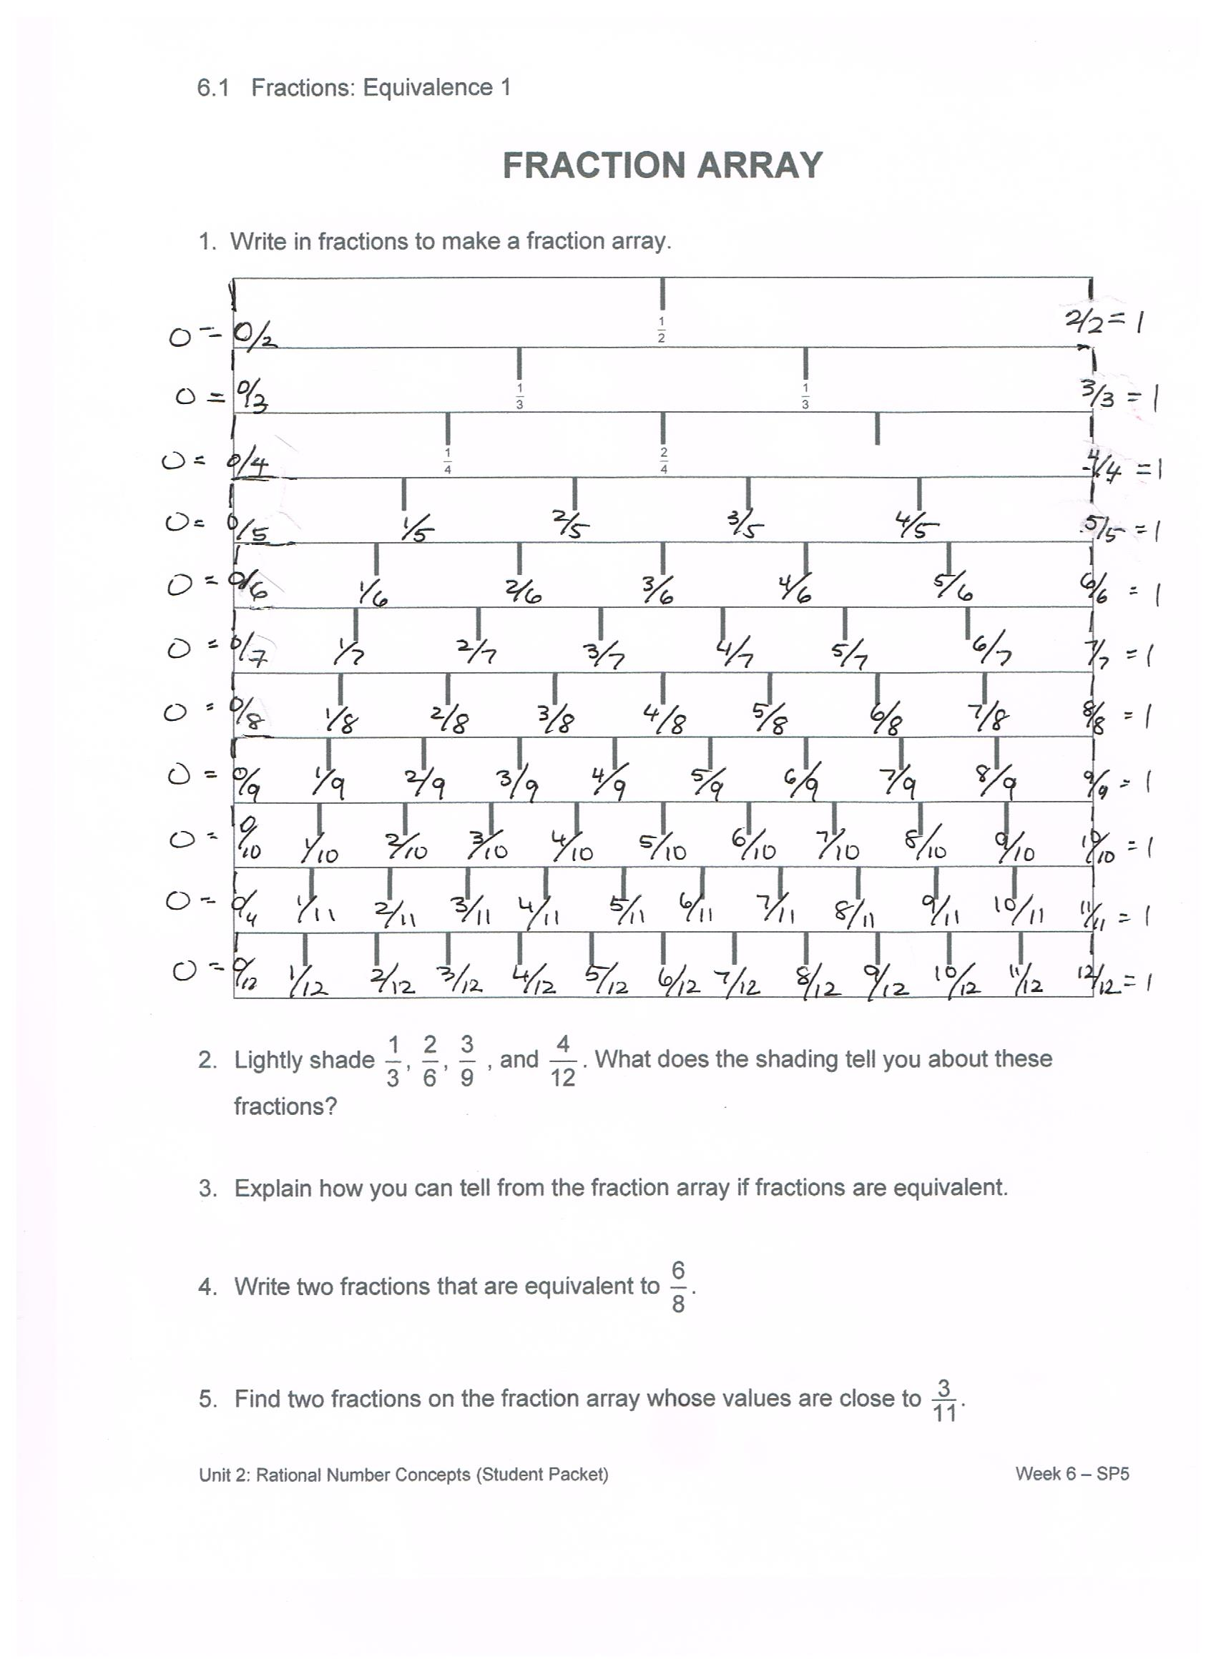
FRACTION STRIPS 2
Notes:
Then we fold thirds, sixths, ninths, twelfths…
Finally we make this array. If you’d like to know a nifty trick for accurately making 5ths, 7ths, 11ths, contact me. I promise you’ll love it!!
We like to ask a bunch of concept questions along the way…
How can you tell when two fractions are equivalent?
A fraction is greater than ½?
If two fractions have same numerator, how can you tell which has greater value?
Same denominator…which has greater value?

Slide 17
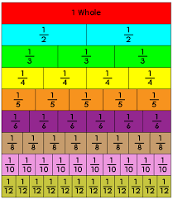
ANOTHER ARRAY
Notes:
This is a common manipulate (that I don’t like much because I always lose the pieces…but I digress)
How is it different from the linear model we made? It’s an area model!

Slide 18
STRATEGIES FOR ORDERING FRACTIONS STRATEGY 1
Notes:
Ordering fraction strategies help develop number sense with little computation.
Shown here is a unit fraction strategy: Larger the denominator, smaller the fraction.

Slide 19
STRATEGIES FOR ORDERING FRACTIONS STRATEGY 2
Notes:
Here’s a close relative of unit fraction strategy. These are all a unit fraction from 1, so reverse logic applies. Larger the denominator, larger the fraction

Slide 20
STRATEGIES FOR ORDERING FRACTIONS STRATEGY 3
Notes:
Another cousin of unit fractions. These all have the same denominator… larger the denominator, smaller the fraction

Slide 21
STRATEGIES FOR ORDERING FRACTIONS STRATEGY 4
Notes:
The classic!

Slide 22
STRATEGIES FOR ORDERING FRACTIONS STRATEGY 5
Notes:
Comparing to ½. I really like this one. If denominator is more than double the numerator, the fraction is more than 1/2

Slide 23
STRATEGIES FOR COMPARING FRACTIONS
Unit fractions (distance from 0)
1 - unit fractions (distance from 1)
Common numerators (multiples of unit fractions)
Common denominators (the classic)
Comparison to ½ (creativity)
Notes:
Summary

Slide 24
CONCEPT DEVELOPMENT Equivalence and Ordering
Estimate the placement of these fractions
on the number line.
0
1
Notes:
Try placing these on the number line using the strategies.

Slide 25
FRACTIONS IN “SIMPLEST FORM”
The area of this rectangle is one whole.
What fraction is shaded?
Is the same amount shaded now?
What is the equivalent fraction?
So
We call this the
“Big 1.”
Notes:
Equivalence is a big deal. This animation shows how to use “the big one” to write a fraction with a smaller denominator

Slide 26
RENAMING FOUR-SIXTHS
of this rectangle is shaded.
Is the same amount shaded now?
What is the equivalent fraction?
So
“Big 1”
Notes:
And this animation shows how to write it with a larger denominator.

Slide 27
RENAMING SHORTCUTS
Change a mixed number into an improper fraction.
What number is represented by this picture? How do you know?
Shortcut
Generalize!!
Notes:
This animation helps to explain why our mixed number → improper fraction shortcut makes sense

Slide 28
ANOTHER SHORCUT
Change an improper fraction into a mixed number.
What number is represented by this picture? How do you know?
Generalize!!
Notes:
And this one is the reverse

Slide 29
MENTAL MATH
Find the missing addend
Find the difference
Notes:
This is an important mental math strategy. Students should be able to find a missing fraction to make 1 whole without too much difficulty. It’s useful for an upcoming subtraction strategy you will see here

Slide 30
SUMMARY OF FRACTION CONCEPTS
Meaning of a fraction
Ordering fractions
Equivalent fractions (the big 1)
Renaming fractions
Adding up to 1, subtracting from 1
Notes:
summary

Slide 31
FRACTION SUBTRACTION
Notes:
This slide deck goes into detail about subtraction. Addition not included, but it does follow similar (simpler) logic. If you are interested in more, please contact me (shelley@mathandteaching.org)

Slide 32

FRACTION SUBTRACTION PROTEIN BARS: MIXED NUMBERS
Draw a diagram and record computations to illustrate these actions.
You have three and three-fourths protein bars.
You give one and one-eighth bars away.
How much do you have left?
Subtract the whole numbers first.
Subtract the fractional parts next.
3 – 1 = 2
Then add the remaining pieces.
Notes:
Please animate this one slowly to see how we can match pictures to computations to make sense of subtraction. Notice that computations are horizontal (preferred organization in algebra) and we avoid the messy regrouping step.

Slide 33
PROTEIN BARS: IMPROPER FRACTIONS
Draw a diagram and record computations to illustrate these actions.
You have three and three-fourths protein bars.
You give one and one-eighth bars away.
How much do you have left?
Change to improper fractions.
Find a common denominator
Subtract the fractions.
Notes:
Same problem using improper fractions. The computations are simpler, but the size of numbers is greater.

Slide 34
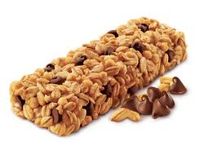
NUT BARS: MIXED NUMBERS
Draw a diagram and record computations to illustrate these actions.
You have one and one-half nut bars.
You eat five-eighths of a bar.
How much do you have left?
Subtract the fraction from the whole number first.
Add the remaining pieces.
Notes:
Another animation to unpack

Slide 35
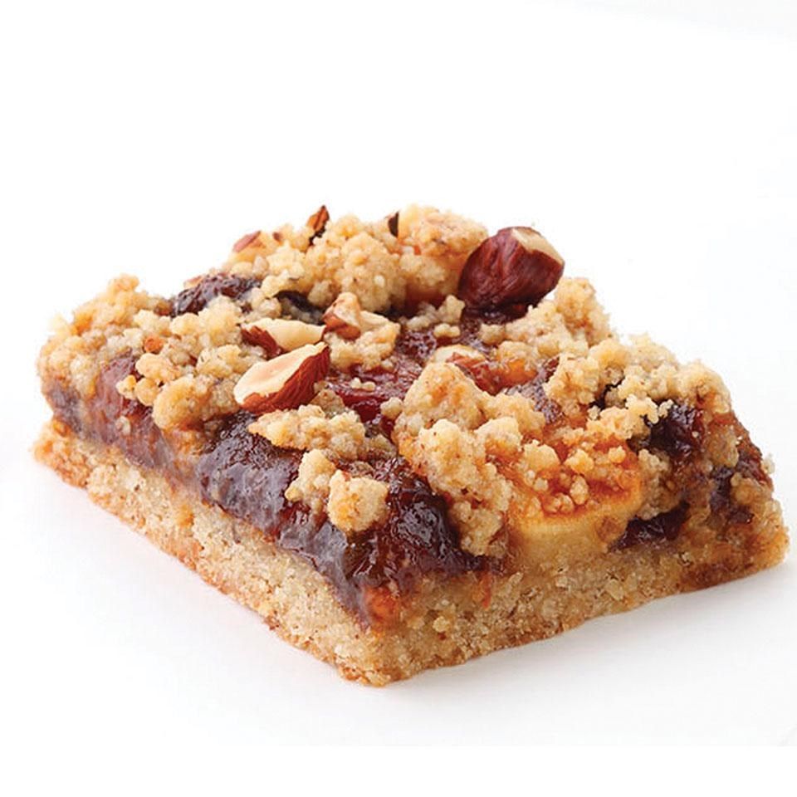
FRUIT BARS: MIXED NUMBERS
Draw a diagram and record computations to illustrate these actions.
You have three and one-fourth fruit bars.
You give two and one-half bars to a friend.
How much do you have left?
Subtract the whole numbers first.
Subtract the fraction from the remaining whole number
3 – 2 = 1
Add the remaining pieces
Notes:
And one ore example with mixed numbers and a process that avoids regrouping.

Slide 36
FRACTION DIVISION
Notes:
Again, I didn’t include multiplication here. Division has more twists and turns…

Slide 37
MEASURE OUT DIVISION
(1) How many groups of 2 are in 6?
(2) How many groups of are in ?
Notes:
First we look at two parallel problems to make sense of them.
(With fraction division, problems often fall into the “measure out” category, rather than the “divvie up / dealing” category)

Slide 38
ANALYZING PROBLEMS 1-2
Groups of 2 in 6 6 ÷ 2
Groups of in ÷
6 is the whole amount
is the whole amount
measure out groups of 2
measure out groups of
There are 3 groups of 2 in 6,
so 6 ÷ 2 = 3
There are 3 groups of in
so ÷ = 3
Notice ÷
=
= 3
Notes:
Animation connects words to pictures to symbols.
Notice that dividing across on the second example gives the correct quotient

Slide 39
MORE MEASURE OUT DIVISION
(3) How many groups of 2 are in 5?
(4) How many groups of are in ?
Notes:
Another example that will have a remainder to interpret

Slide 40
ANALYZING PROBLEMS 3-4
Groups of 2 in 5 5 ÷ 2
Groups of in ÷
5 is the whole amount
is the whole amount
measure out groups of 2
measure out groups of
There are 2 groups of 2 in 5,
so 5 ÷ 2 = 2
There are 2 groups of in
so ÷ = 2
Notes:
Please animate and unpack

Slide 41
CONNOR’S CAKE
Connor eats of a small cake. A serving is of a cake. How many servings does Connor eat?
How many servings of are in ?
is the whole amount
Connor eats servings.
measure out servings of
Connor eats servings.
Notes:
A word problem to solve with pictures, words, and numbers

Slide 42
MIA’S CEREAL
Mia eats cup of cereal. A serving size is cup. How many servings does Mia eat?
How many servings of are in ?
Mia eats serving.
is the whole amount
measure out serving of
Mia eats serving.
Notes:
Another word problem. This one is a bit trickier to interpret.

Slide 43
SUMMARIZE AND PRACTICE
The divide-across rule for fractions
Try these:
Notes:
Not convinced that divide across works? Try these and convince yourself!

Slide 44

DIVISION: INVERT AND MULTIPLY
Division is subservient to multiplication because it is defined as the inverse of multiplication. That is why you take the inverse and multiply.
Ted Gamelin
Mathematician emeritus
UCLA Department of Mathematics
Notes:
This is what our mathematician explained to me about division. Personally, I found his explanation very unsatisfying. That’s another reason why I like divide across…. It is similar to multiplication (multiply across).

Slide 45
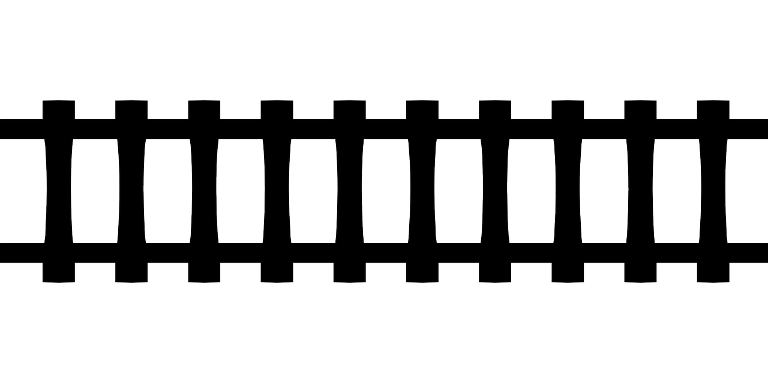
GETTING STUDENTS BACK ON TRACK
IF…
High Expectations
AND…
Backfill and front load with
major work of the grade
THEN…
Students will have
more success AND more confidence!
Notes:
Hope you got some ideas about how to get all your duckies back on track with fractions.

Slide 46

The Center for Mathematics and Teaching
Non-profit 501(c)(3)
www.mathandteaching.org/essentials/
Shelley Kriegler
shelley@mathandteaching.org

