Slide 1
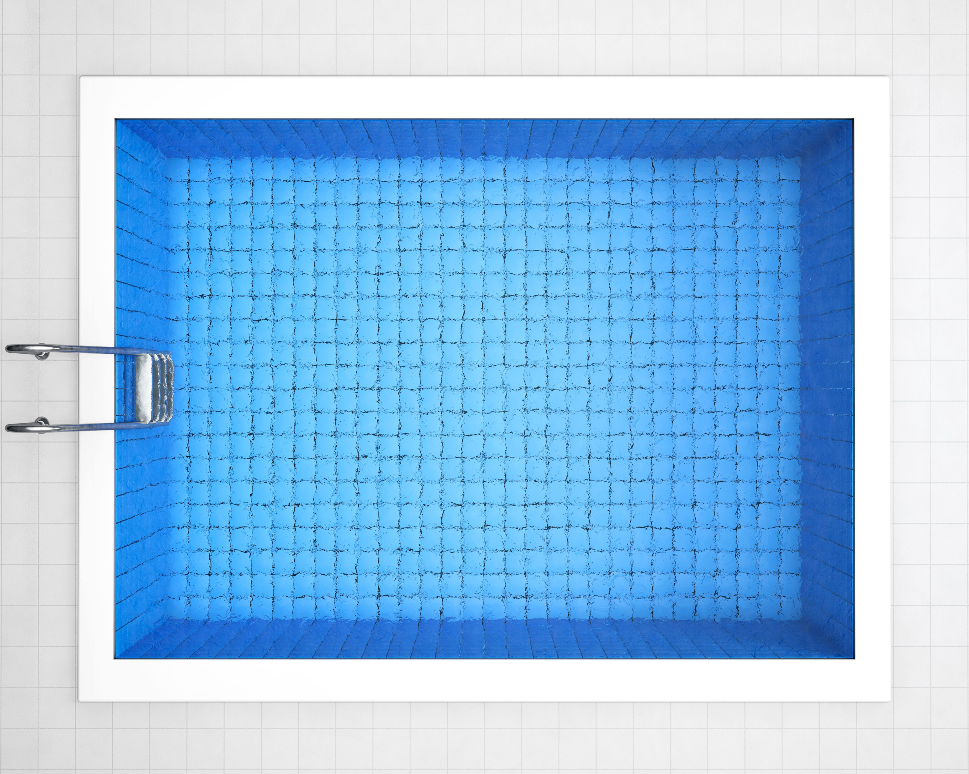
THE POOL PROBLEM
This is a picture of the start of a “pool” pattern.
The outer squares represent border tiles, and the inner squares represent the water.
Pool 1
Pool 2
small squares are
1 unit × 1 unit
What are some things you notice?
What do you think Pool 3 looks like?

Slide 2
NEXT STEPS
Pool 1
Pool 2
Pool 3
(1) Describe in words the way the water and the border patterns are changing.
(2) Copy Pools 1 – 3. Then draw Pool 4.
For the Border AND the Water patterns:
(3) Fill in the tables.
(4) Make graphs.

