Slide 1

DOUBLE NUMBER LINES AND EQUATIONS
Suppose 4 baseballs cost $10. Assume you can buy any number of baseballs at this same rate.
(1)
Complete the fact statement. Make a double number line showing costs for different quantities of baseballs.
dollars
# of baseballs
0
10
20 30 40
0
4
8 12 16
What does this statement (equation) mean in the context above?

Slide 2
RELATIONSHIP 1
0 10 20 30 40
dollars
# of baseballs
0 4 8 12 16
What does this statement mean?
(2) a. Copy the “if-then” statement above.
Generalize the meaning of this if-then statement.
c. Write another true if-then statement based on the double number line that illustrates this relationship.

Slide 3
RELATIONSHIP 2
0 10 20 30 40
dollars
# of baseballs
0 4 8 12 16
What does this statement mean?
(3) a. Copy the if-then statement above.
Generalize the meaning of this if-then statement.
c. Write another true if-then statement based on the double number line that illustrates this relationship.

Slide 4
RELATIONSHIP 3
0 10 20 30 40
dollars
# of baseballs
0 4 8 12 16
What does this statement mean?
“Cross-Multiplication Property.”
(4) a. Copy the “if-then” statement above.
b. Generalize the meaning of this if-then statement.
c. Write another true if-then statement based on the double number line that illustrates this relationship.

Slide 5
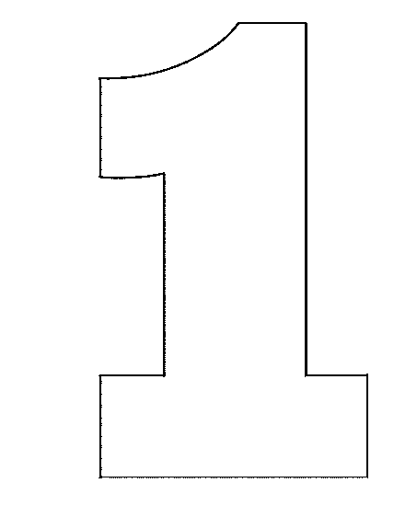
USING THE CROSS-MULTIPLICATION PROPERTY
(5) How much will 9 baseballs cost if 4 baseballs cost $10? Use the double number line to set up the equation. Use the cross-multiplication property to solve it.
x
0 10 20 30 40
dollars
# of baseballs
0 4 8 12 16
9
cross-multiplication property
(6) Use a ratio other than 10:4. Write a different equation and solve for x.
22.5 = x
9 baseballs will cost $22.50.

Slide 6

WHY DOES CROSS-MULTIPLICATION WORK?
4 baseballs cost $10. How much will 9 balls cost?
x
0 10 20 30 40
dollars
# of baseballs
0 4 8 12 16
9
From the double number line
Multiplication property of equality
Multiplication property of 1
Cross-multiplication property
10$•$9 = 4x

