Slide 1
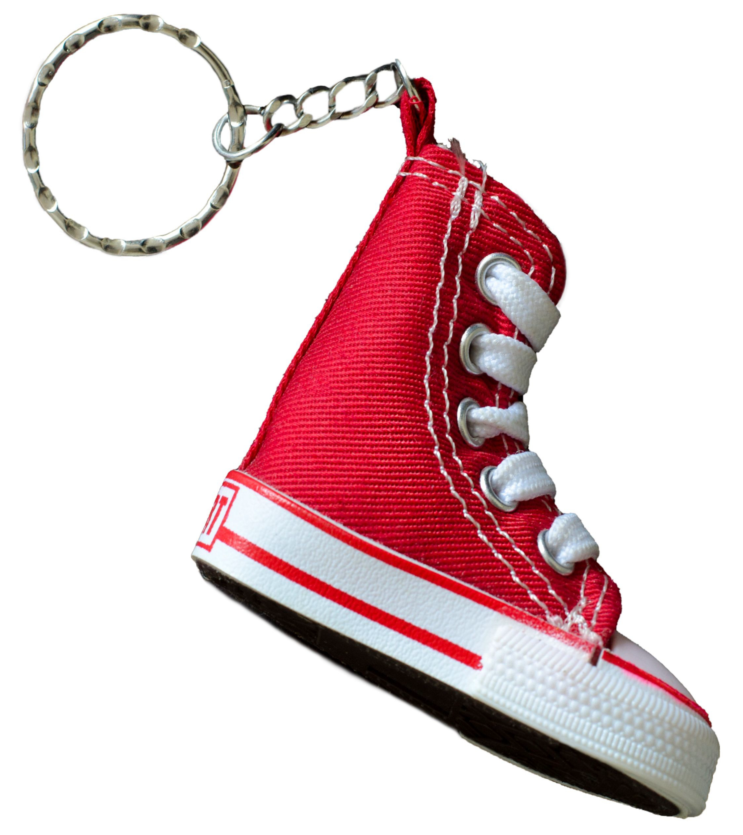
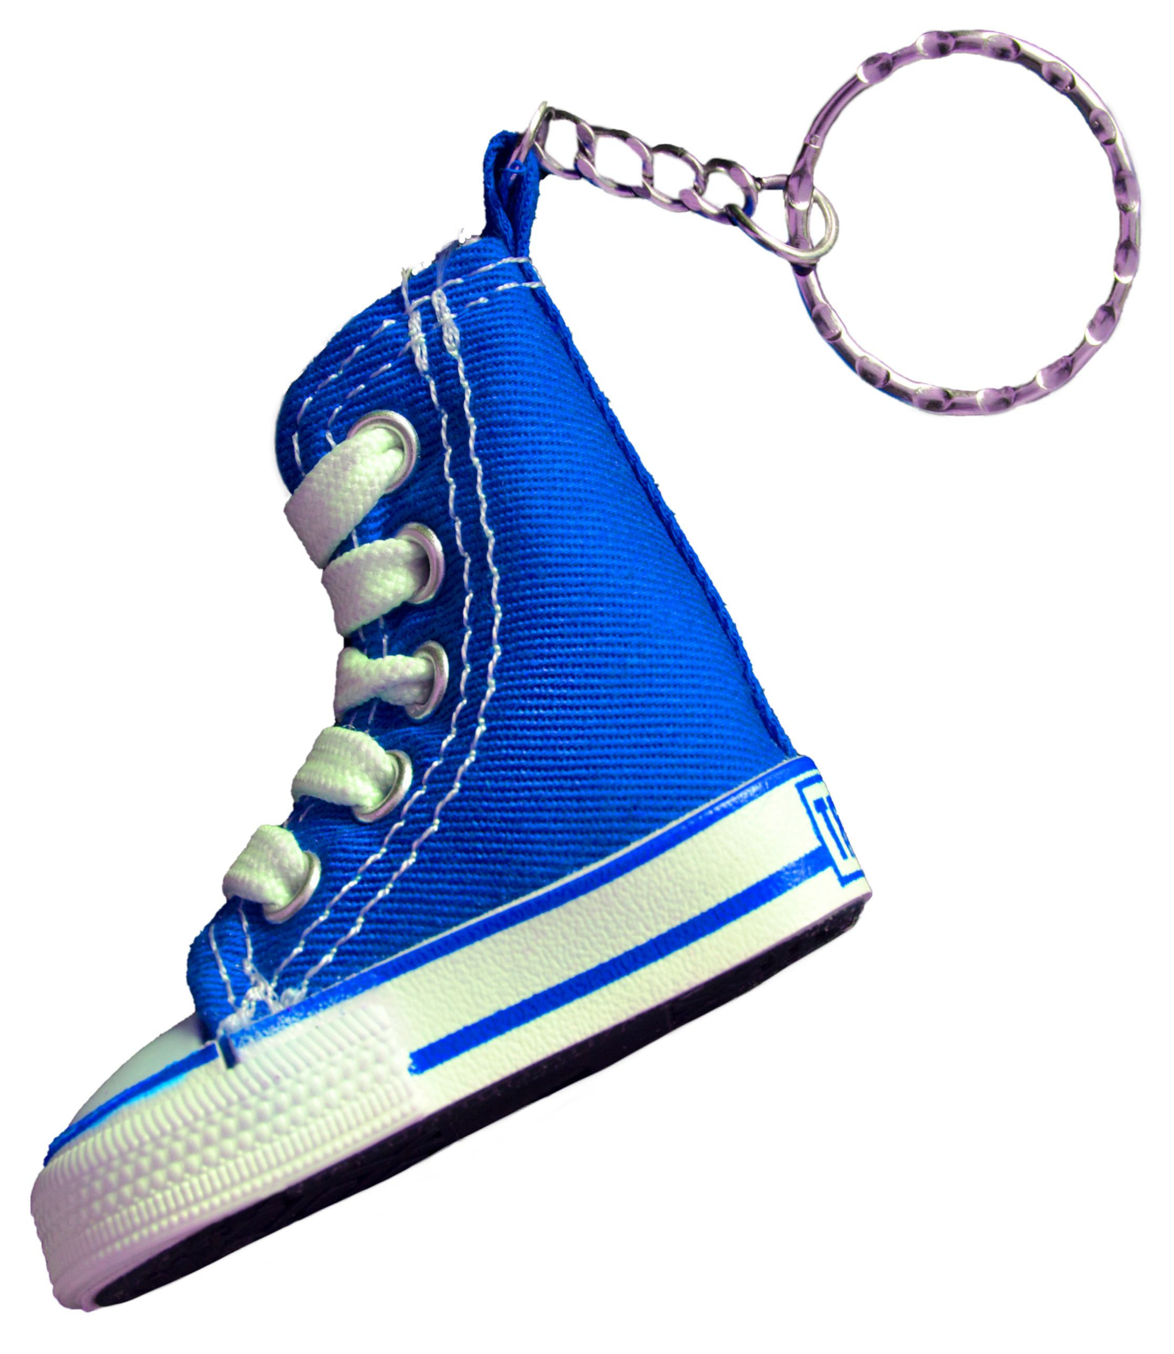
THE KEYCHAIN FUNDRAISER
The Lincoln Middle School fundraising committee wants to sell keychains to raise money for the big dance.
Keychains are packaged and sold in small quantities.
(1a) Copy the pricing information for the Hi-Tops keychains.
HI-TOPS
2 for $3.00
(1b) Complete a table that relates the number of keychains (quantity) and cost.
(1c) Write an input-output rule that relates quantity and cost.
(1d) Complete a double number line.

Slide 2
FROM NUMBER LINES TO GRAPHS
Cost in $
quantity
0 1 2 3 4 5 6
How do double number lines relate to coordinate planes?
Cost
(1e) Complete a graph.
0 1 2 3 4 5 6
quantity

Slide 3
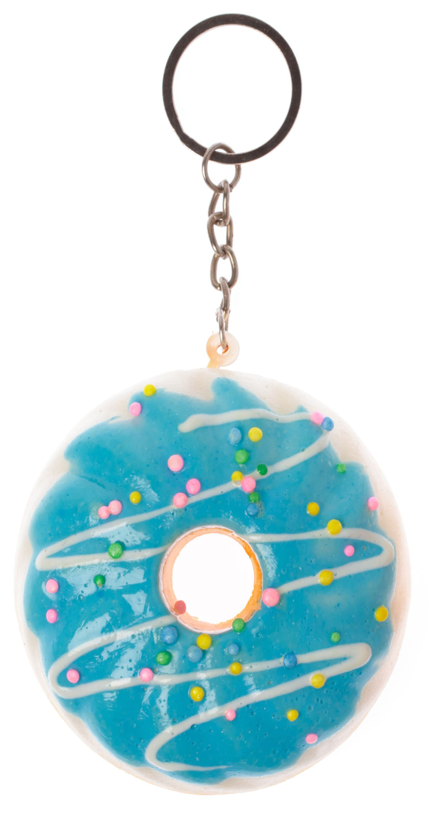
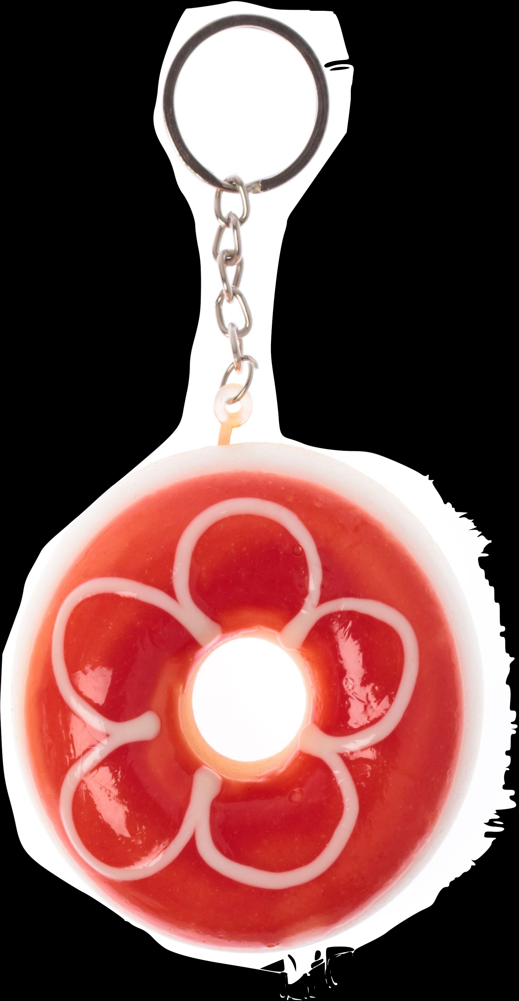
UNIT PRICE
HI-TOPS
2 for $3.00
What is the unit price and what does it mean in this context?
(2a-2e)
For the Donuts keychains:
DONUTS
3 for $4.00
Copy the pricing information.
Complete a table, equation, double number line, and graph (round as needed).
Which keychain has the lower unit price?

