Slide 1

6-7 MATH TALKS
Data Talks (Slides 2-9)
Picture Talks (Slides 10-12)
Number Talks (Slides 13-15)

Slide 2
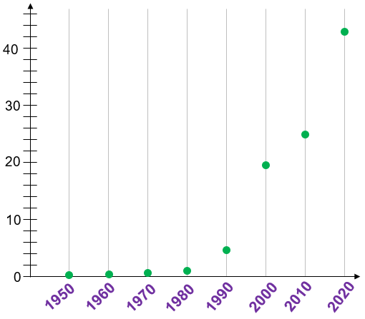
DATA TALK A
What’s happening
with this graph?
What are some
quantities that might
have increased like this
from 1950 to 2020?

Slide 3
DATA TALK A
Any more
thoughts?
dollars
in
millions

Slide 4
DATA TALK A
Highest paid NBA player at the start of each decade
(annual salary)
43,006,362
Anything
surprise you?
dollars
in
millions
24,806,250
19,600,000
Any ideas who the players are?
15,000
65,000
380,000
1,000,000
4,250,000
Source: https://en.wikipedia.org/wiki/List_of_highest-paid_NBA_players_by_season

Slide 5
DATA TALK A
1950 George Mikan Minneapolis Lakers
1960 Wilt Chamberlain Philadelphia 76ers
1970 Pete Maravich Atlanta Hawks
1980 Moses Malone Philadelphia 76ers
Julius Erving Philadelphia 76ers
Bill Walton San Diego Clippers
Kareem Abdul Jabbar Los Angeles Lakers
1990 Patrick Ewing New York Knicks
2000 Kevin Garnett Minnesota Timberwolves
2010 Kobe Bryant Los Angeles Lakers
2020 Stephen Curry Golden State Warriors
Anything
surprise you?
Did you identify any of them?

Slide 6
DATA TALK A
1950 George Mikan $15,000
1960 Wilt Chamberlain $16,000
1970 Pete Maravich $380,000
1980 Moses Malone $1,000,000
Julius Erving
Bill Walton
Kareem Abdul Jabbar
1990 Patrick Ewing $4,250,000
2000 Kevin Garnett $19,600,000
2010 Kobe Bryant $24,806,250
2020 Stephen Curry $43,006,362
All of the highlighted players main position was guard.
Find the percents of one player’s salary compared to another’s:
Maravich to Curry
Bryant to Curry

Slide 7
DATA TALK A
1950 George Mikan $15,000
1960 Wilt Chamberlain $16,000
1970 Pete Maravich $380,000
1980 Moses Malone $1,000,000
Julius Erving
Bill Walton
Kareem Abdul Jabbar
1990 Patrick Ewing $4,250,000
2000 Kevin Garnett $19,600,000
2010 Kobe Bryant $24,806,250
2020 Stephen Curry $43,006,362
What are the mean and median amounts for these player salaries over these decades?
Does one of these measures better represent this data set compared to the other?

Slide 8
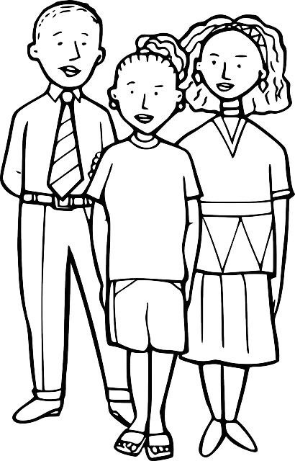
DATA TALK B
FACTS AND STATISTICS
Do teens like spending time with their parents?
75
About ___ % enjoy spending time with parents
What number seems too low?
Too high?
About right?

Slide 9
DATA TALK B
FACTS AND STATISTICS
Do they think highly of their parents?
87
About ___ % think highly of them
What number seems too low?
Too high?
About right?

Slide 10
PICTURE TALK A
Step 1
Step 2
Step 3
How is the pattern growing?
What will Step 4 look like?
How many objects are in Step 5?
Use words or algebraic symbols to represent the number of objects in ANY step (a rule for Step n).
Does a rule make it easier to determine the number of objects in Step 5 or Step 12?

Slide 11
PICTURE TALK B
Step 1
Step 2
Step 3
How is the pattern growing?
What will Step 4 look like?
How many objects are in Step 5?
Use words or algebraic symbols to represent the number of objects in ANY step (a rule for Step n).
Does a rule make it easier to determine the number of objects in Step 5 or Step 12?

Slide 12
PICTURE TALK C
Step 1
Step 2
Step 3
How is the pattern growing?
What will Step 4 look like?
How many objects are in Step 5?
Use words or algebraic symbols to represent the number of objects in ANY step (a rule for Step n).
Does a rule make it easier to determine the number of objects in Step 5 or Step 12?

Slide 13
NUMBER TALK A
Is it better to… | Option 1 | Option 2
 | share $50 among 8 friends | share $96 among 16 friends
Which option would you choose?
Be prepared to explain your reasoning.

Slide 14
NUMBER TALK B
Is it faster to… | Option 1 | Option 2
 | read a 360-page book over 5 days (same amount per day) | read a 240-page book over 5 days (same amount per day)
Which option would you choose?
Be prepared to explain your reasoning.

Slide 15
NUMBER TALK C
Is it more to… | Option 1 | Option 2
 | run 60 miles over 15 days (same amount per day) | run 40 miles over 12 days (same amount per day)
Which option would you choose?
Be prepared to explain your reasoning.

