Slide 1
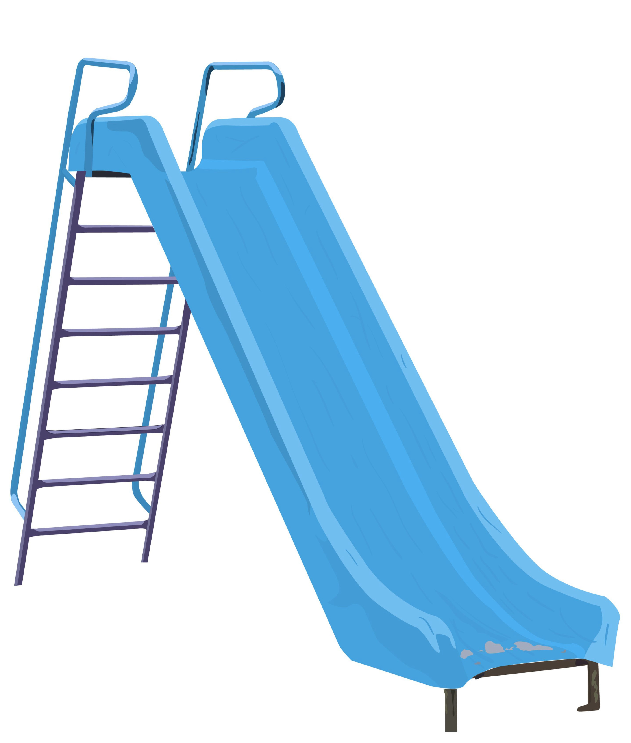

SLIDES AND JUMPS
Here’s the challenge:
By sliding and jumping, get the colored markers to switch positions.
R
B
Level 1
Almost done!
Try to complete Level 1.

Slide 2
NEXT LEVEL
A few things to know:
You may slide only one space.
You may jump over only one space with a counter in it.
You may slide or jump backward to complete a level, but…
try to make the fewest moves possible.
R
B
Level 2
I’m stuck!
Try to complete Level 2.

Slide 3
MORE LEVELS
When ready, try to complete more levels.
R
B
Level 3
What will Level 4 look like?

Slide 4
RECORDING SLIDES AND JUMPS
How many moves does it take to complete ANY level?
Remember we’re looking for the fewest moves per level.
Let’s start by recording slides and jumps move-by-move.
Remember Level 1?
S J S
(1) Record like this for each level you’ve done.
What pattern(s) do you notice?
Record more levels.

Slide 5
TABLES AND GRAPHS
(2) Record moves in a table.
Generalize for ANY level (“Level x”).
Level # | # of Slides | # of Jumps | Total # of Moves
1
2
3
4
5
2
1
3
4
4
8
6
9
15
8
16
24
10
25
35
x
2x
x²
2x + x²

