Slide 1

TWINKIE THE DOG
Thank you, Dan Meyer, for the use of this 3-Act Math Lesson.
Click the video to start playing.
What do we know?
What do you wonder?

Slide 2
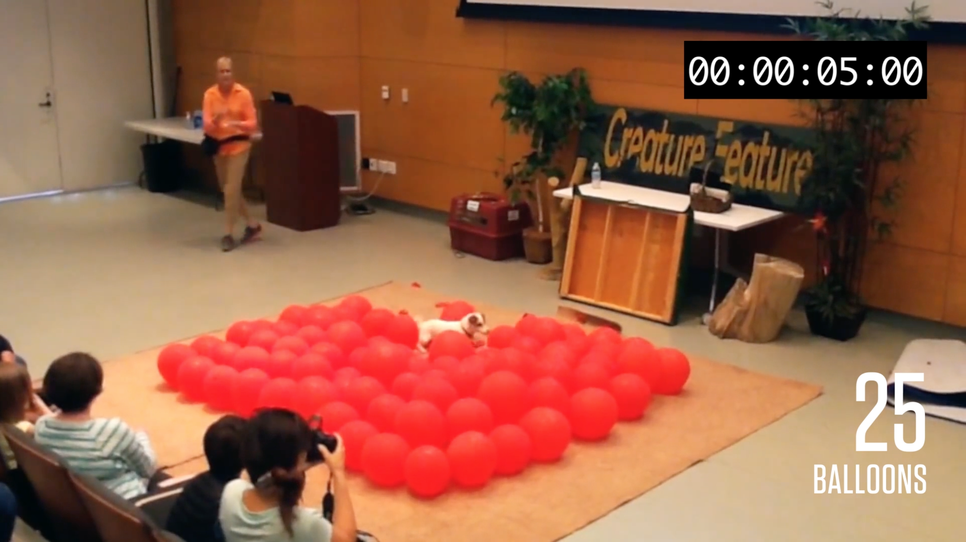
ESTIMATING TWINKIE’S SUCCESS
How long do you think it will take to pop them all?
(1) Make a prediction.
(2) Assume a proportional relationship between the number of balloons popped and elapsed time. Create a double number line to show this relationship.

Slide 3
FROM NUMBER LINES TO GRAPHS
# of balloons
Time (in sec)
0 1 2 3 4 5 6
# of balloons
How do double number lines relate to coordinate planes?
(3) Complete a graph using data from your double number line.
0 1 2 3 4 5 6
Time (in sec)

Slide 4
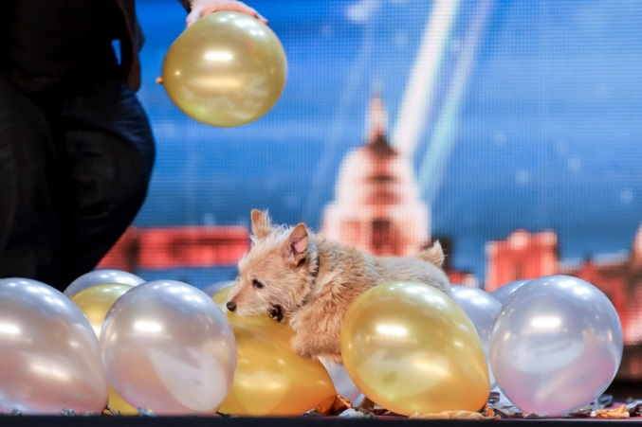
CALLY’S WORLD RECORD
Another Jack Russell Terrier, Cally, completed the feat in an incredible 41.67 seconds on “Britains Got Talent” on May 15, 2015.
(4) Do you think Twinkie will break Cally’s record? Explain.
Do you think your mathematical answer is going to match the actual answer?

Slide 5

TWINKIE, THE DOG
June 28, 2016
Click the video to start playing.
Did the result surprise you? If so, how?

Slide 6

A CLOSER LOOK AT THE DATA
(5) Replay the video. Stop along the way to collect data. Use your data to complete the table and graph.
(6) Does the pace of Twinkie’s balloon breaking record represent a proportional relationship? Explain.

