Slide 1
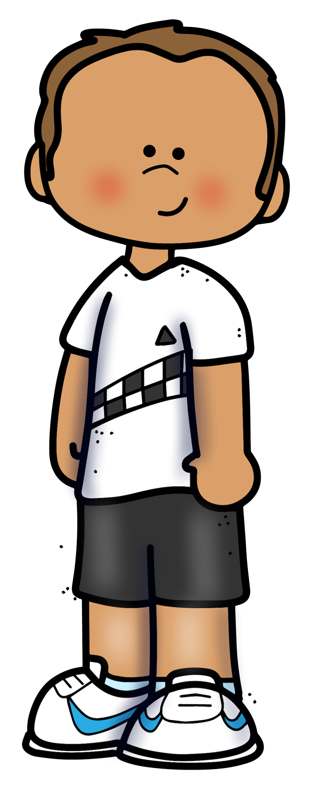

A VOCABULARY MATCHING ACTIVITY
Work with a partner and two sets of cards.
I have ‘s
One partner has the set,
the other has the set.
First match your own I-II-III-IV word cards to your A-B-C-D description cards.
I have ‘s
Discuss both sets of cards with your partner.
Be sure you agree the matches are correct.
Record the matching card numbers, words, and card letters for each set in the table.

Slide 2
Let’s compare
Here are the word cards for “I”
What is the SAME about them?
What is DIFFERENT about them?
expression
equation
Sometimes we solve for an unknown.
may have only one term
Includes variables, constants, operation signs
Sometimes we simplify or evaluate this
Two expressions that are equal to each other
Includes terms
Includes an equal sign (=)
Ex: 4x + 3 = 7
No equal sign (=)
Ex: 4x + 3
Choose another pair of number matched cards. Discuss and record what is the same and what is different about them.

