Slide 1
SMASH Game 4
Science | Math | Art | Sports | History
100 | 100 | 100 | 100 | 100
200 | 200 | 200 | 200 | 200
300 | 300 | 300 | 300 | 300
400 | 400 | 400 | 400 | 400
500 | 500 | 500 | 500 | 500

Slide 2

Science - 100
What is the phase of the moon pictured below?
Answer
Notes:
The Sun

Slide 3
Science - 100
Answer: Full Moon

Slide 4

Science - 200
Which species of shark is considered to be
the most deadly?
Answer
Notes:
Tsunami

Slide 5
Science - 200
Answer: The Great White Shark

Slide 6

Science - 300
What comprises 70% of the Earth’s surface?
Answer
Notes:
0

Slide 7
Science - 300
Answer: Water

Slide 8
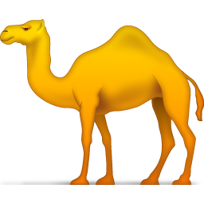
Science - 400
Located in Africa, what is the world’s largest hot desert?
Answer
Notes:
40-50 years

Slide 9
Science - 400
Answer: Sahara

Slide 10
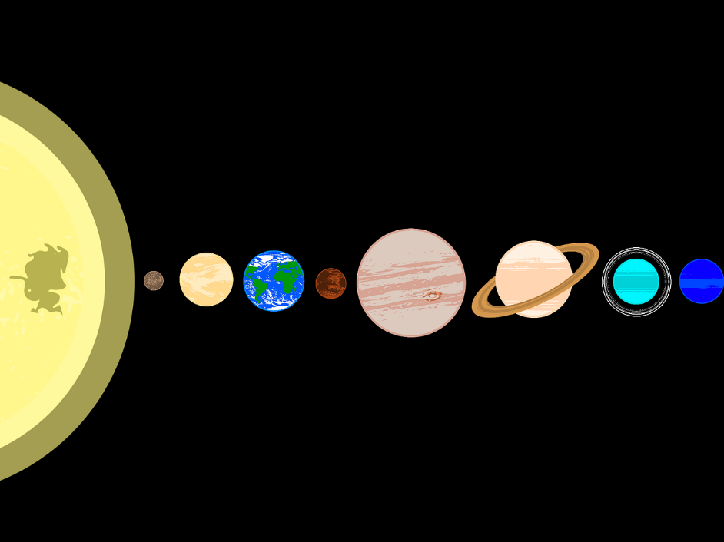
Science - 500
Who named the planets after their gods?
Answer
Notes:
The Femur

Slide 11
Science - 500
Answer: The Romans

Slide 12

Sports - 100
In soccer, how many players are on the field
for each team?
Answer
Notes:
26 miles

Slide 13
Sports - 100
Answer: 11

Slide 14

Sports - 200
In which water sport, involving a ball, are players not allowed to touch the bottom of the pool?
Answer
Notes:
90 feet

Slide 15
Sports - 200
Answer: Water Polo

Slide 16

Sports - 300
In a gymnastic competition, in how many events can females compete?
Answer
Notes:
10 feet

Slide 17
Sports - 300
Answer: Four

Slide 18
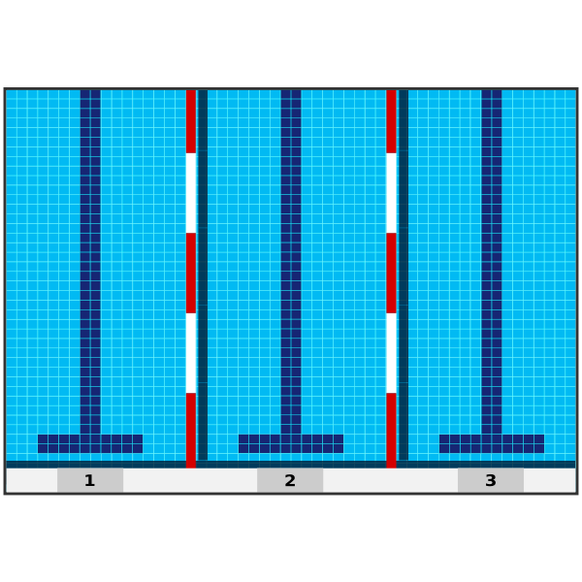
Sports - 400
In an Olympics-size pool, how many laps across the pool is 100 meters?
Answer
Notes:
Butterfly, Backstroke, Breaststroke, Freestyle

Slide 19
Sports - 400
Answer: 2

Slide 20

Sports - 500
In a professional football field, how much greater is the length (goal post to goal post) than the width?
Answer
Notes:
Moses Fleetwood Walker

Slide 21
Sports - 500
Answer: 200 feet
(360 feet long)
(160 feet wide)

Slide 22
Math - 100
How many lines of symmetry does a square have?
Answer
Notes:
2

Slide 23
Math - 100
Answer: Four

Slide 24

Math - 200
Which two whole numbers are neither prime nor composite?
Answer
Notes:
Pythagoras

Slide 25
Math - 200
Answer: 0 & 1

Slide 26
Math - 300
What is the name of the triangle that has only two congruent sides?
Answer
Notes:
four

Slide 27
Math - 300
Answer: Isosceles triangle

Slide 28

Math - 400
In Base 2, how is the number 5 represented?
I’m a binary number!
Answer
Notes:
13

Slide 29
Math - 400
Answer: 101
(1 four, 0 twos, 1 one)

Slide 30

Math - 500
Which 3 cubic numbers add to 153?
Answer
Notes:
125

Slide 31
Math - 500
Answer: 1, 27, and 125

Slide 32

History - 100
Which U.S. state has the greatest population?
Answer
Notes:
13

Slide 33
History - 100
Answer: California

Slide 34

History - 200
Canada was “born” as a separate country from Great Britain 91 years after the U.S. Declaration of Independence was signed.
When did Canada become a separate country?
Answer
Notes:
13

Slide 35
History - 200
Answer: 1867
(Canada became a separate country on July 1, 1867 [1776 + 91])

Slide 36

History- 300
Which U.S. state has the greatest land area?
Answer
Notes:
300 (million)

Slide 37
History - 300
Answer: Alaska

Slide 38

History - 400
The Wall Street Crash of 1929 led to what historical event in the US?
Answer
Notes:
1945.

Slide 39
History - 400
Answer: The Great Depression

Slide 40
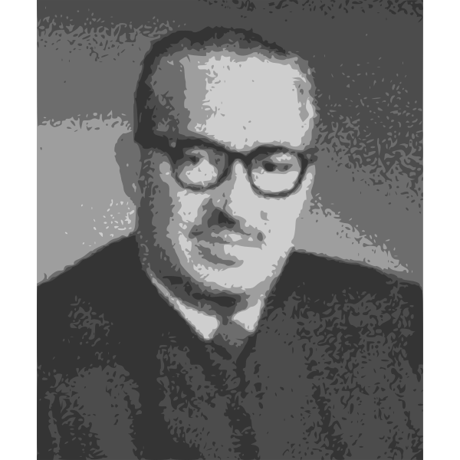
History - 500
Thurgood Marshall, appointed by
President Lyndon Johnson,
was the first African American to
serve in what capacity in the
U.S. government?
Answer
Notes:
1912

Slide 41
History - 500
Answer: Supreme Court Justice

Slide 42
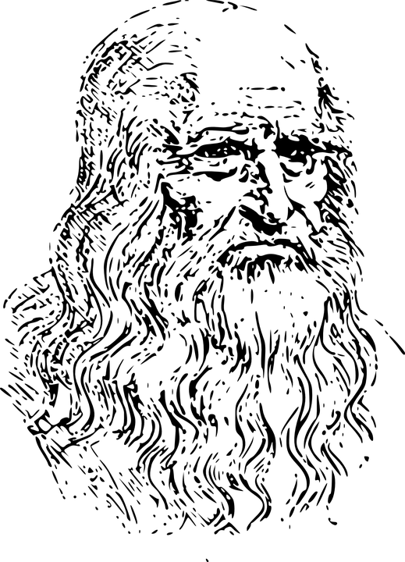
Art - 100
Leonardo da Vinci is known for painting which portrait of a beautiful woman?
Answer
Notes:
Green, Orange, Violet (Purple)

Slide 43
Art - 100
Answer: The Mona Lisa

Slide 44
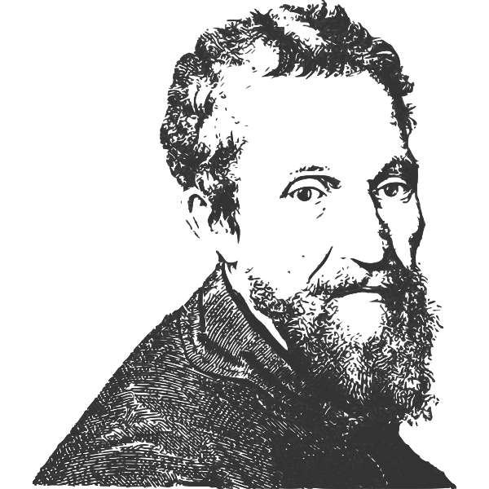
Art - 200
Michelangelo is best known for his painting of the ceiling in what structure?
Answer
Notes:
Vincent van Gogh.

Slide 45
Art - 200
Answer: Sistine Chapel

Slide 46
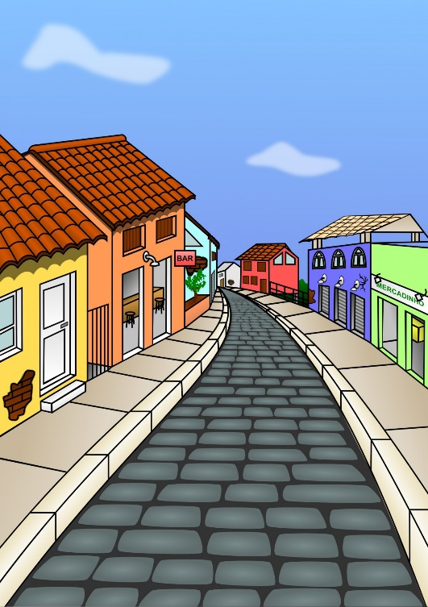
Art - 300
What is the name of the system of drawing in which objects get smaller and closer together as they are farther away?
Answer
Notes:
The Lion King

Slide 47
Art - 300
Answer: Perspective Drawing

Slide 48
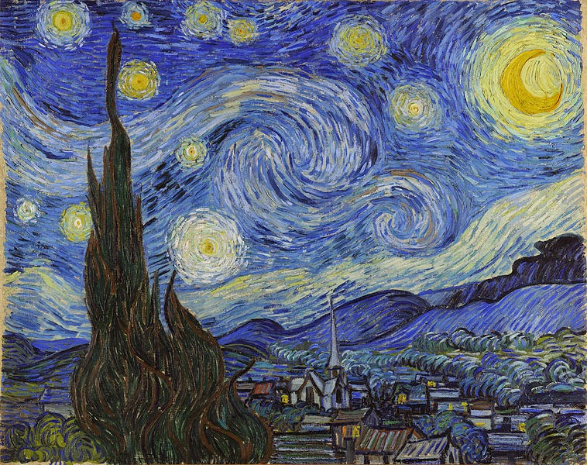
Art - 400
Who painted “Starry Night”?
Answer
Notes:
Athena.

Slide 49
Art - 400
Answer: Vincent van Gogh

Slide 50
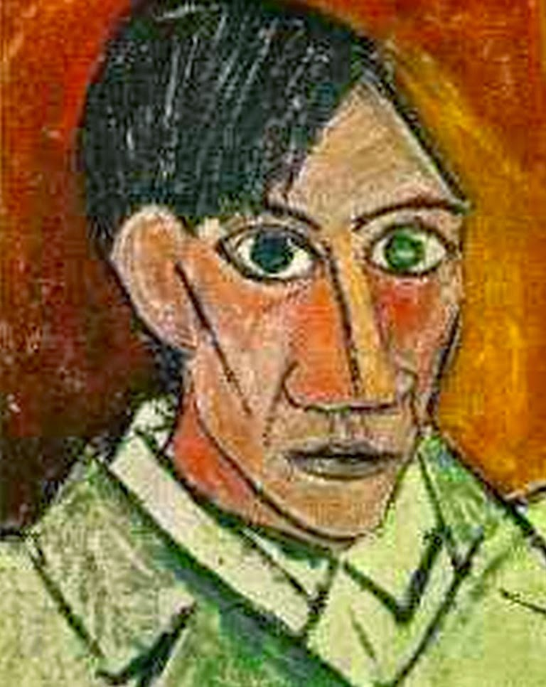
Art - 500
Who was the most prolific artist in terms of number of works produced?
Answer
Notes:
Red, orange, yellow, green, blue, indigo, and violet.

Slide 51
Art - 500
Answer: Picasso

