Slide 1
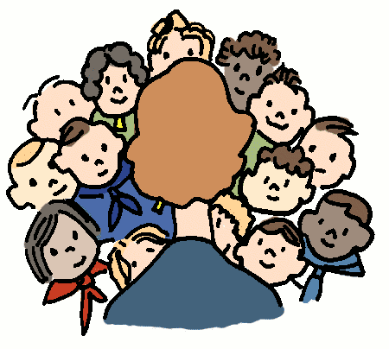
8-3 MATH TALKS
Data Talks (Slides 2-7)
Picture Talks (Slides 8-9)

Slide 2
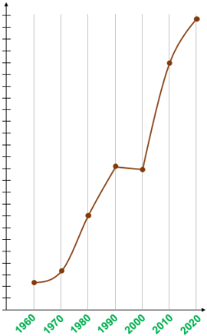
DATA TALK A
What’s happening
with this graph?
What are some
quantities that might
have increased like this
from 1960 to 2020?

Slide 3
DATA TALK A
Here are some clues:
This food item debuted in 1967 in Pennsylvania.
It’s now available in over 100 countries
dollars
One of its original names was the Aristocrat
Any ideas?

Slide 4
DATA TALK A
4.95
More Clues:
4.19
These are average prices across
the US
dollars
2.45
2.39
It has 3 pieces
of bread
1.60
0.45
0.65
Any more ideas?

Slide 5
DATA TALK A
Big Mac Cost by Decade
(approximate average cost)
4.95
4.19
Anything
surprise you?
dollars
2.45
The average price went down.
Can you conjecture why?
2.39
1.60
Research online to see if you are correct!
0.45
0.65

Slide 6

DATA TALK B
TRUE OR FALSE?
Teens sometimes think you are confrontational
when you are not.
The rational part of teen brains is not totally developed. This means that teens rely more heavily on the primitive back parts of the brain to evaluate facial expressions.
Because this part of the brain is more sensitive in detecting threats and danger, it is more likely to believe hostility is present even when it isn’t.
Nagging and criticism can make a teen’s brain shut down.
*Source: https://knoxvillemoms.com/weird-facts-to-help-us-better-understand-teens/

Slide 7
DATA TALK B
Teens sometimes think you are confrontational
when you are not.
How can you avoid misreading
communication signals?
Be aware of this and try to be positive.
Recognize the behavior, and try to be reasonable.
*Source: https://knoxvillemoms.com/weird-facts-to-help-us-better-understand-teens/

Slide 8
PICTURE TALK A vs. B
Image A
Without counting one by one, how many small rectangles are in A?
Image B
Without counting one by one, how many small rectangles are in B?
How did A help you figure out B?

Slide 9
PICTURE TALK A vs. D
Image A
Without counting one by one, how many small rectangles are in D?
Image D
How did A help you figure out D?

